Slide 1
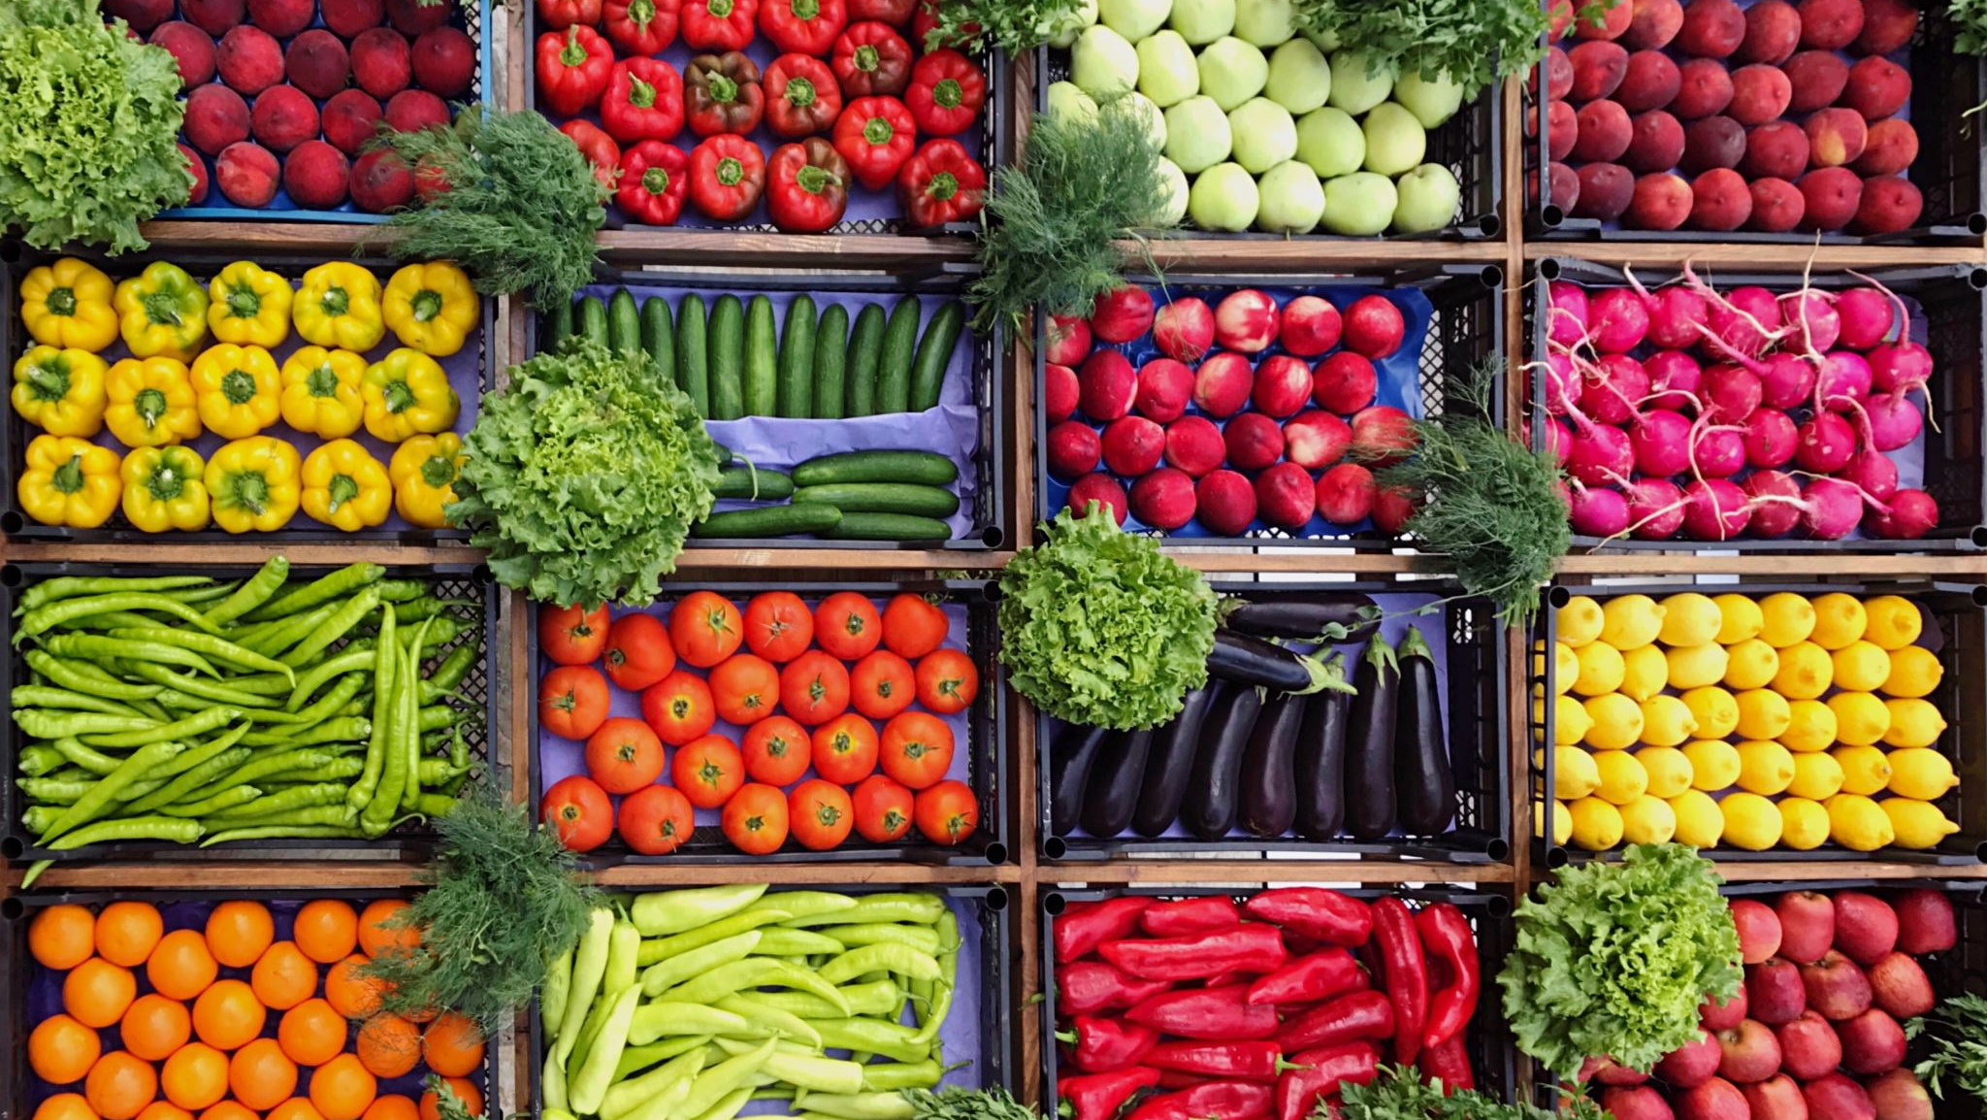
Tria Patrianti Sa’diyah El Adawiyah Nani Nurani Muksin Mariam Universitas Muhammadiyah Jakarta
HALAL LIFESTYLE DURING COVID-19 PANDEMIC; EXPANDING THE SCOPE OF GOVERNMENT PUBLIC RELATIONS IN SHARIA ECONOMY

Slide 2
INTRODUCTION
Increasing awareness of Halal Lifestyle during Covid-19 pandemic
Indonesia’s potential to become the world’s sharia economy
Strengthening the value chain for halal products
Overall Halal Lifestyle Industry rankings, Indonesia continues to grow
Positive implications to business

Slide 3
HALAL LIFESTYLE & GLOBAL SHARIA ECONOMY
More than 229 millions of muslims in Indonesia
Increase demanding halal products and services
1.9 billion Muslims in the world
7 potential sharia economy sectors

Slide 4
Halal Lifestyle in Indonesia during Pandemic
Limited activities during Covid-19
Transformation digital and creative economy
Vice President Ma'ruf Amin encourages the halal lifestyle in Indonesia to be further expanded.
Started with awareness of the importance of halal products or halal awareness among the public

Slide 5
Government Public Relations & Messaging Development
Government public relations : efforts by the government to communicate in a non-partisan, balanced, and concise manner. These efforts are focused on the interests of the receiving citizen who needs to be informed (Gelders & Ihlen, 2010)
The main function of Public Relations requires identification of various communication circuits for shared values. If there are common values, then there are opportunities that can be developed to build the main message of these values.
When it comes to messaging, the government and citizens should share the same values. People can be pretty passive at times. Government public relations might begin by emphasizing ideals that encourage public participation. As a result, while developing messages, government public relations sticks to the 'do not preach' approach while encouraging people to take action (Dimitrov, 2018)

Slide 6
PROBLEM STATEMENT
The development of the halal industry in Indonesia is actually more focused on halal certification. Public awareness of the halal lifestyle is not accompanied by the government's efforts to communicate the importance of the halal lifestyle through messaging development and dissemination by government public relations. This causes low public awareness of the importance of having a halal lifestyle. During a pandemic, the opportunity to communicate a halal lifestyle is actually very high. Various institutions related to halal and sharia economy hardly synergize communication messages of the importance of halal lifestyle.

Slide 7
METHODOLOGY
Data Collection : observation & in-depth interview (Founder of Halal Lifestyle Center /a former deputy of Ministry of Tourism/Halal expert & Producer of TV Program titled “ Sharia Economy Talk”
Case Study
Qualitative Approach

Slide 8
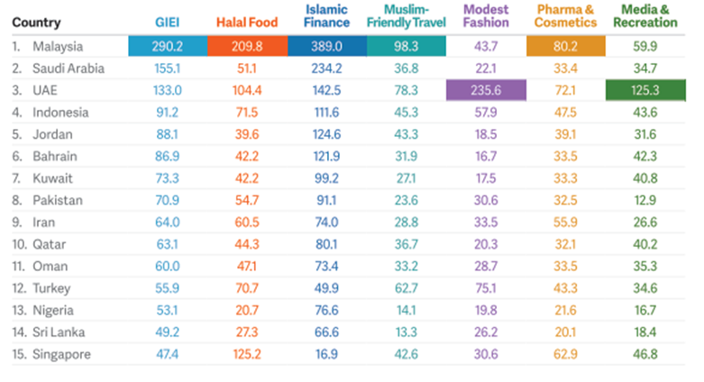
FINDINGS & DISCUSSIONS
Souce :
(Dinar Standard, 2020)

Slide 9
FINDINGS & DISCUSSION
Muslim consumers spent US$2.02 trillion in 2019 on halal food, beverage, pharmaceuticals, and tourism ( State of Global Islamic Economy Report 2020-2021).
The Indonesian government seeks various ways to play a bigger role in the sharia economy, in halal industry, sharia finance, sharia social finance, and sharia entrepreneurship.
The policies : the establishment of a Special Economic Zone (SEZ) for the halal industry. President Joko Widodo as Chairman of the National Committee for Sharia Finance (KNEKS) launched the Master Plan for the Indonesian Sharia Economy (MEKSI) 2019-2024 in May 2019 . In February 2020, KNKS changed to the National Committee for Sharia Economy and Finance (KNEKS).
KNEKS formed to promote the development of the Islamic economic and financial ecosystem to support national economic development and economic resilience.

Slide 10
FINDINGS & DISCUSSIONS
During pandemic, the shariah sector increased especially in the pharmaceutical and food sectors. People started looking for halal food and medicine consumption. However, there is still a lack in literacy of halal lifestyle .
The key messages can be created with an educational aspects, not only contain dogmas. As for various halal events- related have been held, the delivery of halal messages and a halal lifestyle has not become the main target.
There was no government spokesperson to explain the importance of a halal lifestyle and Indonesia's potential to become the world's largest sharia economy center.
Therefore, there is no main message that synergizes all ministries or institutions and the integration of messages for the halal industry, and the halal lifestyle, has not been maximally disseminated to the public

Slide 11
FINDINGS & DISCUSSIONS
The Stakeholders in Halal Lifestyle : The Halal Product Assurance Agency (Ministy of Religion), Halal Tourism (Ministry of Tourism and Creative Economy), Shariah Financial and its Halal ecosystem (The Ministry of Finance), Sharia economic management formula. (Central Bank / Bank of Indoensia), The integration of various sectos (The National Committee for Sharia Economy and Finance).
During Pandemic, METRO TV airs Sharia Economy Talks to infom halal lifestyle with different speakers from Islamic finance observers, ambassadors from OIC member countries, academics, Islamic finance practitioners, to celebrities who implement halal lifestyle. Tatang Suherman (producer , in an offline interview in 05 May 2021), explained that the Talk Show, which has aired for more than 25 episodes plays an important role in disseminating halal lifestyle messages nationwide. “Government Public Relations can use the program to communicate the grand message of halal lifestyle and sharia economy to increase public’s awareness during this Covid-19 Pandemic”, said Suherman.

Slide 12
FINDINGS & DISCUSSIONS
Vice President of Indonesia as the daily chairman of the National Committee for Sharia Economy and Finance (KNEKS), has always advocated a halal lifestyle. Since The Vice President is a formal leader, the ministries must unite and consolidate all stakeholders including academics, experts, practitioners to convey the message of a halal lifestyle, especially during the pandemic to achieve a better understanding.
A synergy between government institutions to convey messages in an integrated system is highly needed to contribute for Indonesia’s Sharia Economy. Communication messages for the halal lifestyle have value that can be developed. For example, the change of civilization. It means that Muslims must be awakened that the halal lifestyle is to improve the quality of life and change civilization.

Slide 13
CONCLUSION
Indonesia has the opportunities to establish a halal lifestyle and become the global center of Islamic business and finance. This will not be accomplished until effective communication through Government Public Relations with its valued messaging is conveyed to the people in order to disseminate halal lifestyle awareness, create attitudes, and change halal lifestyle behavior. The government has the opportunity to develop a halal lifestyle message during the COVID-19 pandemic to stimulate the achievement of shariah's economic and financial power. Changes in civilisation may begin as early as this year-Covid19 Pandemic, when the Muslims must be constantly reminded of halal values for a better quality of life.

