Slide 1
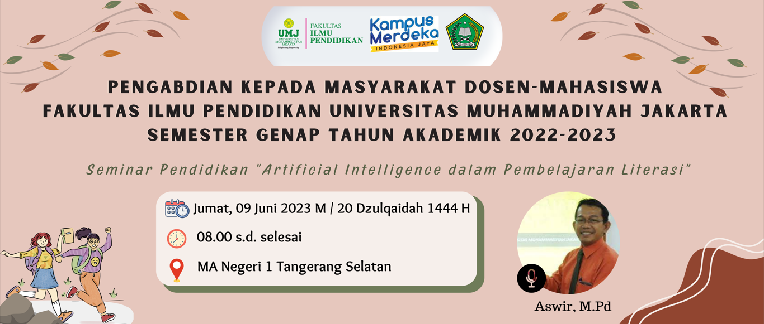

Slide 2
Artificial Intelligence dalam Pembelajaran Literasi
Aswir, M.Pd
Pendidikan Bahasa Inggris Fakultas Ilmu Pendidikan Universitas Muhammadiyah Jakarta

Slide 3
Table of Contents
01
History
02
Actions
03
Relations
04
Best Practices
05
Comparisons
06
Consequences
AI, Robotics, and ChatGPT
AI in Education
AI and Literacy
Modified AI
Challenges and Opportunities
What Next?
Being Creator or Colecctor?

Slide 4
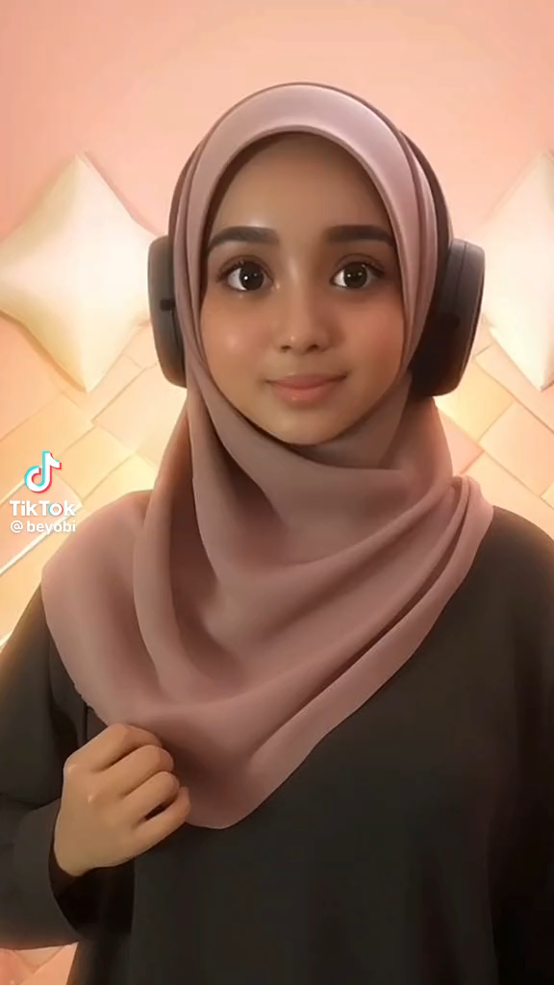
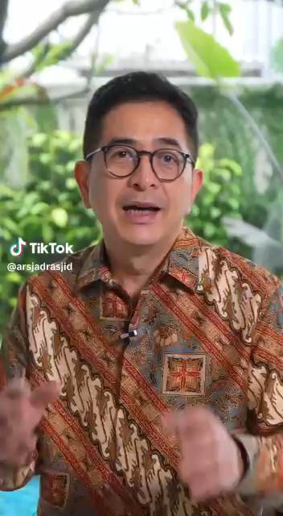

Slide 5
Introduction
AI or Artificial Intelligence passed across three generations.
Gen X
(sweet 70s, migrants)
Gen Y (nice 80/90s, gadgetians
Gen Z (digitized, 2Ks)

Slide 6
01
History
AI, Robotics, ChatGPT
The launch of ChatGPT (Chat Generative Pre-trained Transformer, OpenAI Limited Partnership, San Francisco, USA) on November 30, 2022.
AI began in 1940s
Robotics, 1920s

Slide 7
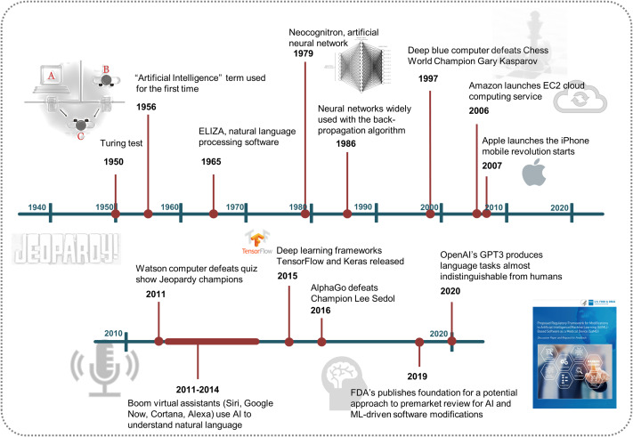

Slide 8
02
Actions
Define the theme in the box below
AI in Education…
Learning Platform
Automation

Slide 9
03
Relations
AI and Literacy
AI accelerates learning.
Literacy needs Multimodal Literacy.

Slide 10
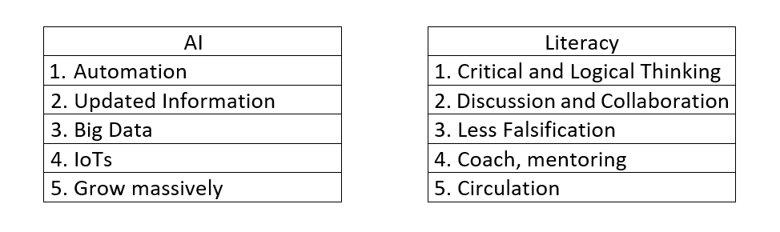
AI and Literacy
Distinctions
AI
Literacy
Back
Next

Slide 11
04
Best Practices
Test your Open AI!

Slide 12
05
Comparisons
Challenges
Opportunities

Slide 13
06
Consequences
What Next?
Being curators? Or Creators?
Machine
Human

Slide 14
Alternative Resources
1. Mahler, Michael. 2021. Precision Medicine and Artificial
Intelligence: The Perfect Fit for Autoimmunity. First Edition.
Elsevier.
2. Krim, Robert M., and Alan Earls. 2021. Boston Made: From Revolution to
Robotics, Innovation that Changed the World. USA: Imagine.

Slide 15
Thanks
Do you have any questions?
aswirsuhud@gmail.com
+21 744 20 28
fipumj.ac.id

