Slide 1
ASUHAN KEPERAWATAN PASIEN PENYAKIT GINJAL KRONIK
Ns. IYAR SISWANDI. Sp.Kep.MB
Dept.KMB FIK UMJ

Slide 2
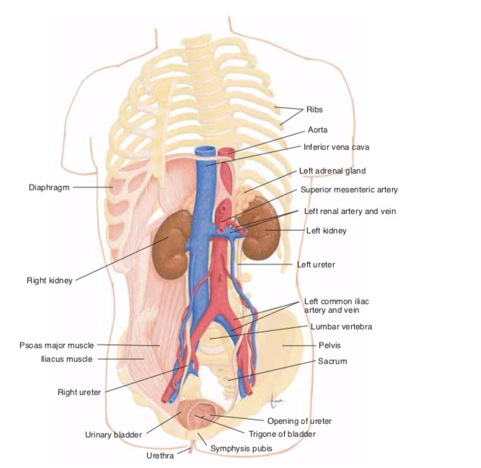
URINARY SISTEM

Slide 3
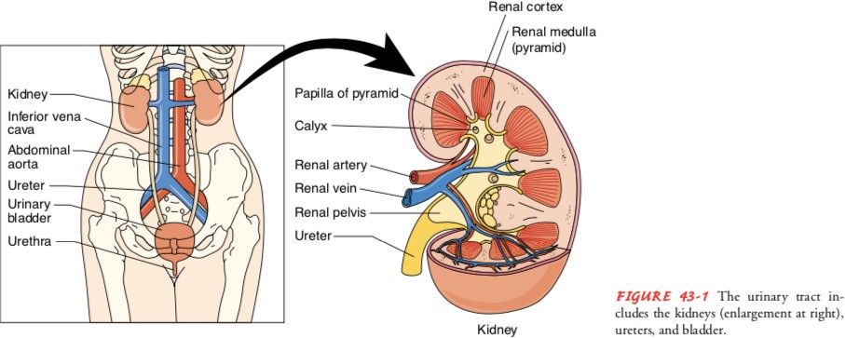
ANATOMI GINJAL

Slide 4
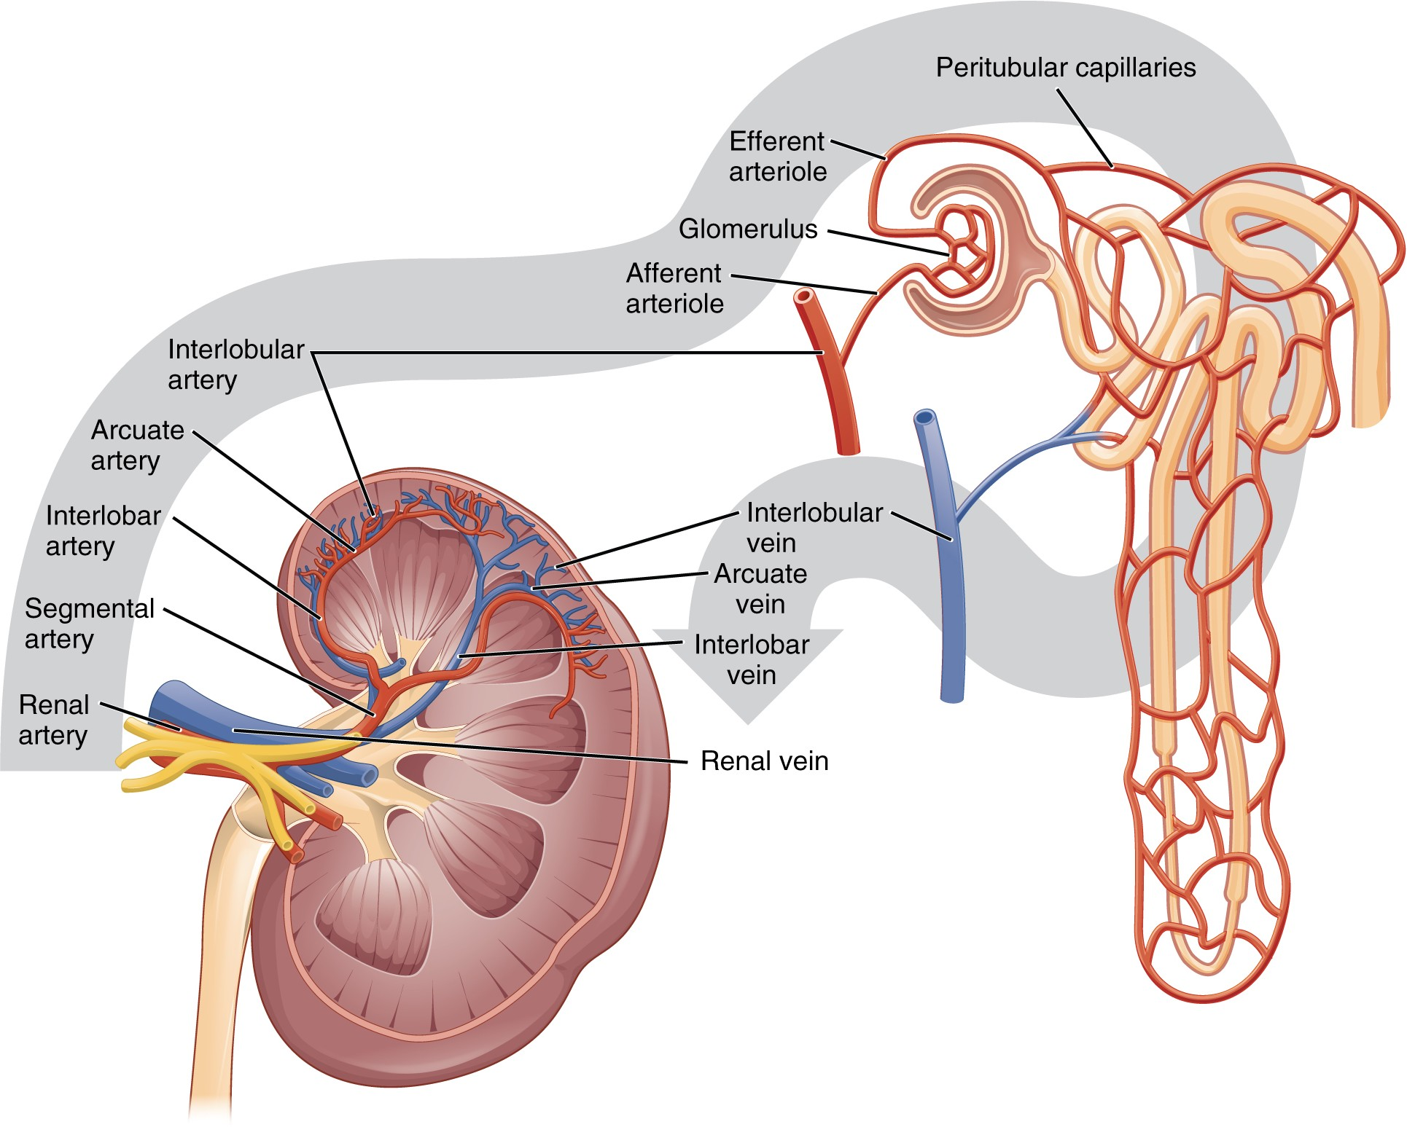
SIRKULASI GINJAL

Slide 5
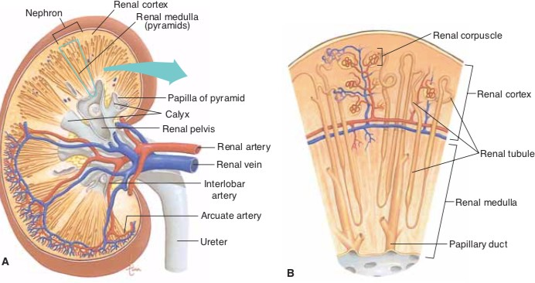
NEPHRON

Slide 6
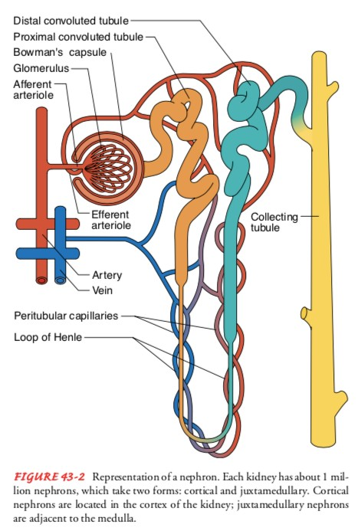
NEPHRON

Slide 7
FUNCTIONS OF THE KIDNEY
D Urine formations
D Excretion of waste products
D Regulation of electrolytes
D Regulation of acid–base balance
D Control of water balance
D Control of blood pressure
D Renal clearance
D Regulation of red blood cell production
D Synthesis of vitamin D to active form
D Secretion of prostaglandins

Slide 8
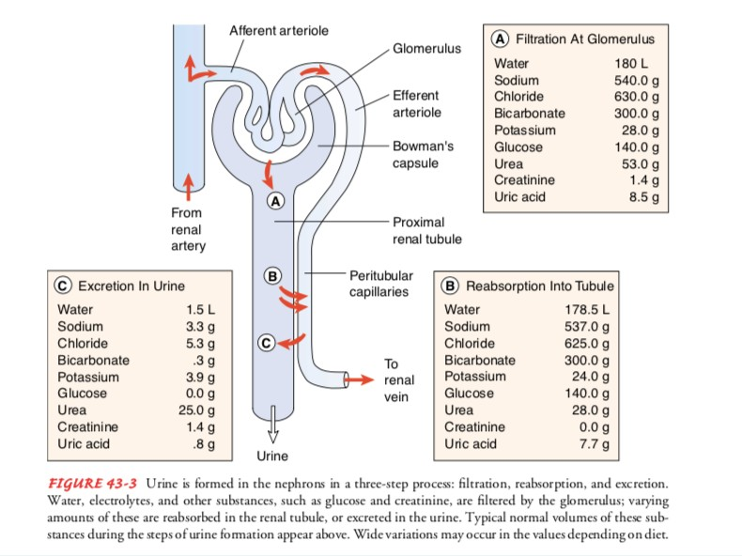

Slide 9
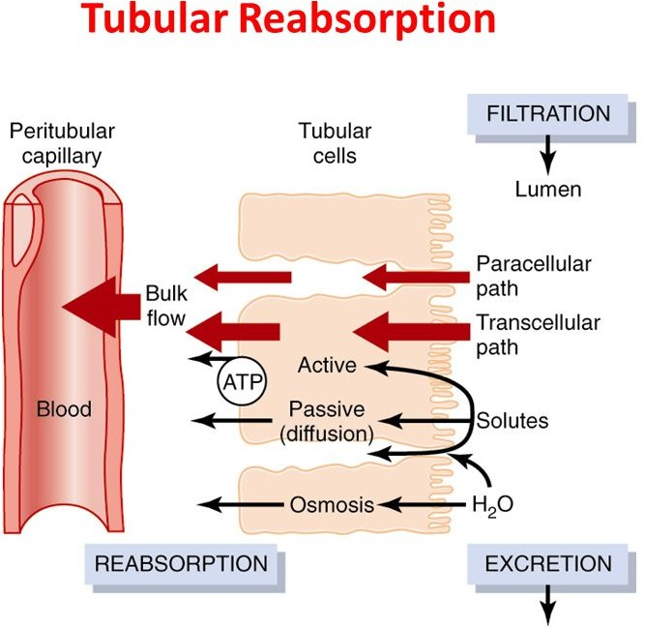
REABSORPSI AIR DAN ZAT TERLARUT
D Zat terlarut di angkut melewati jalur transeluler dengan difusi pasif dan transpor aktif, diantara sel2 (jalur paraseluler) dengan difusi. Air diangkut dengan osmosis. Pengangkutan air dan zat terlarut dari cairan interstisial ke kapiler peritubulus dengan cara bulk flow.

Slide 10
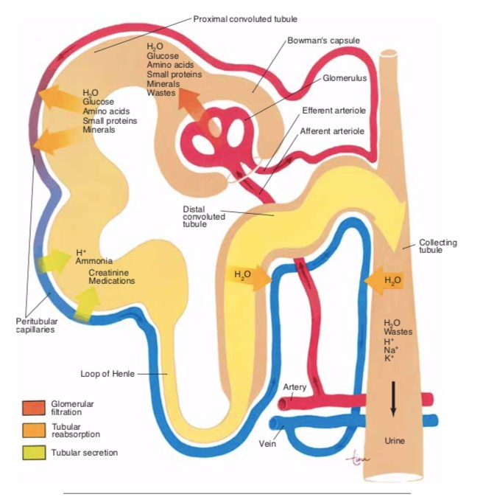
SKEMA FILTRASI DAN REABSORPSI

Slide 11
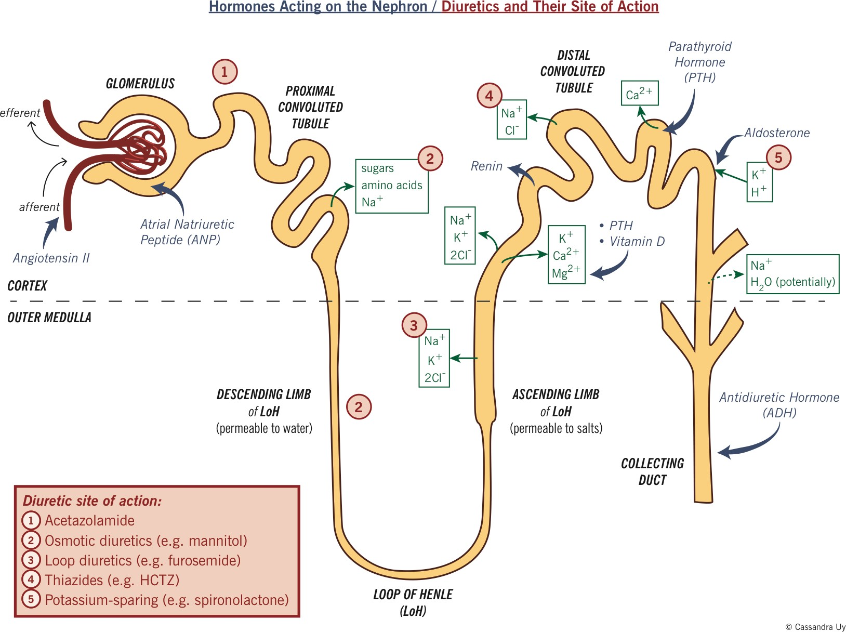
MEKANISME HORMON PADA NEFRON

Slide 12
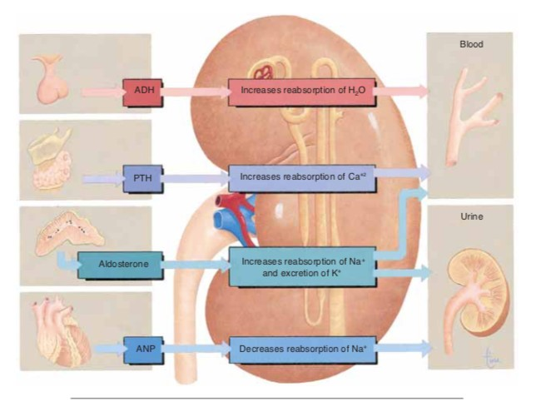
EFEK HORMON TERHADAP GINJAL

Slide 13
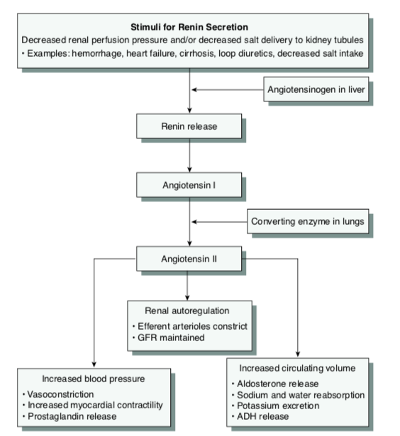
RAA SYSTEM

Slide 14


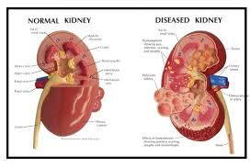
CKD
D Is a progressive, irreversible disorder and kidney function does not recover.
D It is defined as abnormalities in kidney structure or function that alter health and are present for longer than 3 months.

Slide 15
KRITERIA PENYAKIT GINJAL KRONIK (NKF)
D Kerusakan ginjal ≥3 bulan, berupa kelainan struktural atau fungsional dari ginjal, dengan atau tanpa berkurangnya laju filtrasi glomerulus (LFG), dengan manifestasi berupa kelainan patologi atau kelainan laboratorik pada darah, urin, atau kelainan pada pemeriksaan radiologi.
D LGF <60 ml/menit per 1,73 m2 luas permukaan tubuh selama >3 bulan, dengan atau tanpa kerusakan ginjal.

Slide 16



Chronic Renal Disease
D CRF = CKD (chronic kidney disease)
IJ Is irreversible loss of renal function
IJ Classification :
State GFR (ml/mn/1.73m2)
  normal + persistent proteinuria
  60-89 + persistent proteinuria
  30-59
  15-29
  <15 or renal replacement therapy
Persistent at least for 3 months
ESRD : advanced CRF requiring dialysis or transplantation

Slide 17
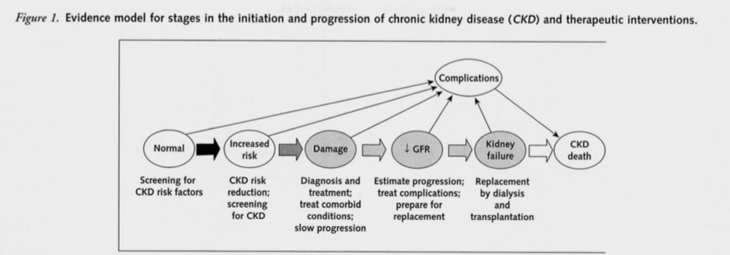

Slide 18



Menghitung GFR
♂ : (140 – umur) x BB
72 x cr
(ml/mnt)☺
Wanita: ♂ x 0.85

Slide 19


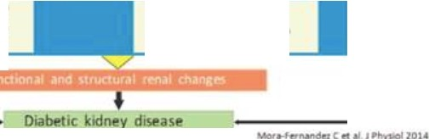
:------1""'"----•1Env,ronmenta1 fict0<s ----
Genttk flctors
■,j@: jl.■
P3thogenic mKhanisms of kidney ,njury
Hyperglytemia
lw\,ri-Ang,otensin-Aldaslerone System
,
Hlr!IOIJtl\l m•0
1nlllffl,1u11011 hlf\,mlftllarf Adhnoon ...ol«11lts
Cll....ot>r l"J
11-f l"II\Otl' c,10-otlft
.\ru,tJII hypf<Wnslo n
w
IOr•Van ,n rtnll ,._llbr rt5ij ban
w
II,':C<e1o""'"'1¥ lr,Plf\tnIIOIi
Altl<tcl 100,u,..,,o;1lf! t
Actrvat•on ot tell signaling path?wa⁻y1 ⁻an⁻d ⁻tra⁻ns⁻c:⁻np.t1⁻on fa⁻cto⁻rs ^{-------•}
Wects related to the cellular ;ind extracellular matrix
l)dll'ql!V011on
,,.olJ,i.too n
l>CfVoe>llv
Aoop i
ICclbct11 $, 141fon«IIII
IConn4Ctvt lliWt
l «IIIOp'1>lt111Ht hil•bon
IMit,,. dlbOfl

Slide 20
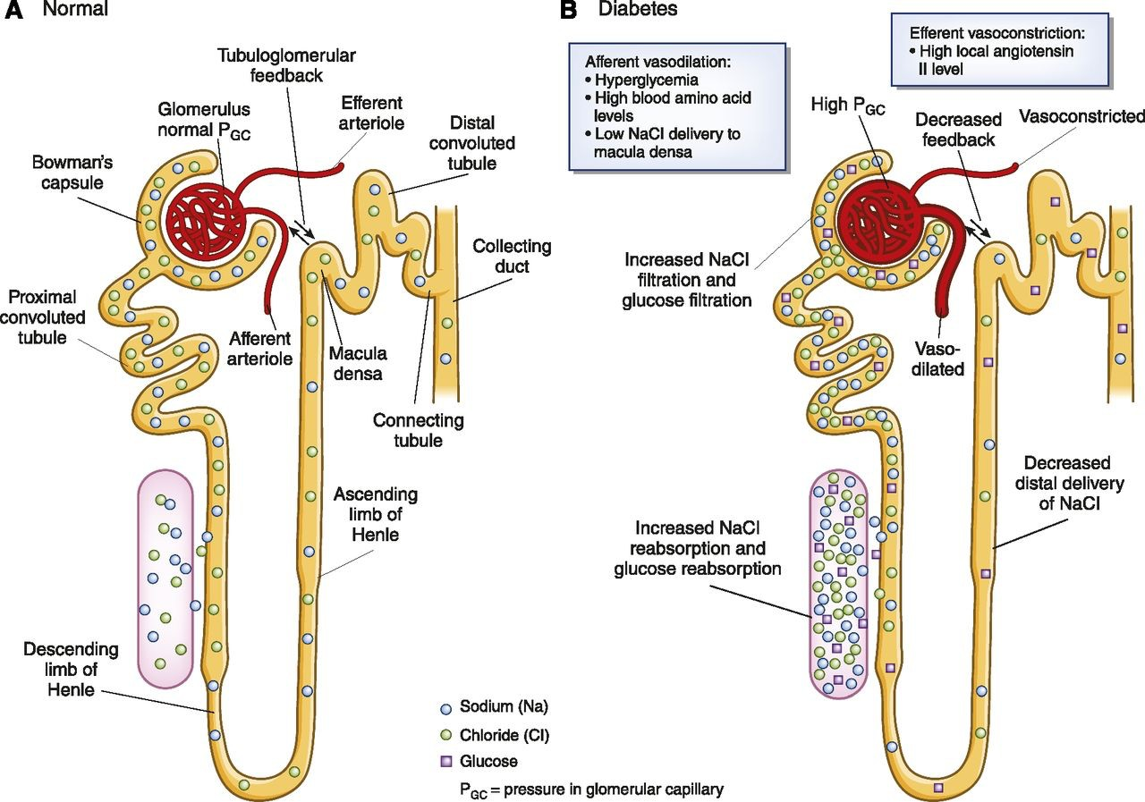

Slide 21
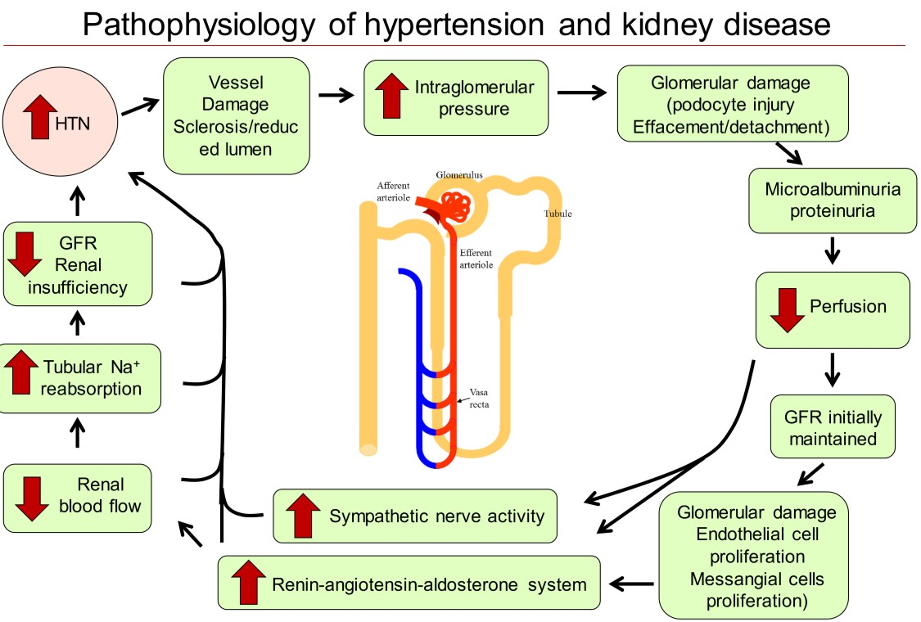

Slide 22
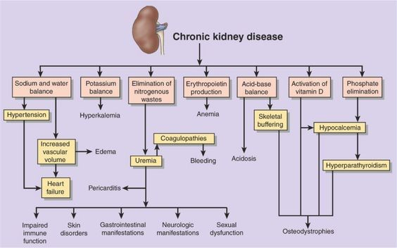
PATOGENESIS

Slide 23
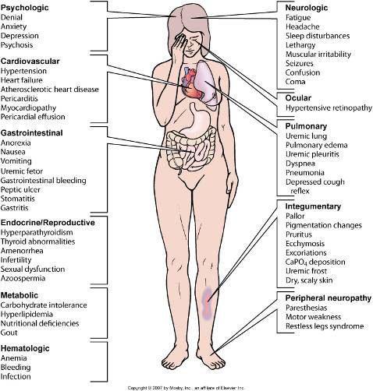
PHYSICAL ASSESSMENT/CLINICAL MANIFESTATIONS

Slide 24
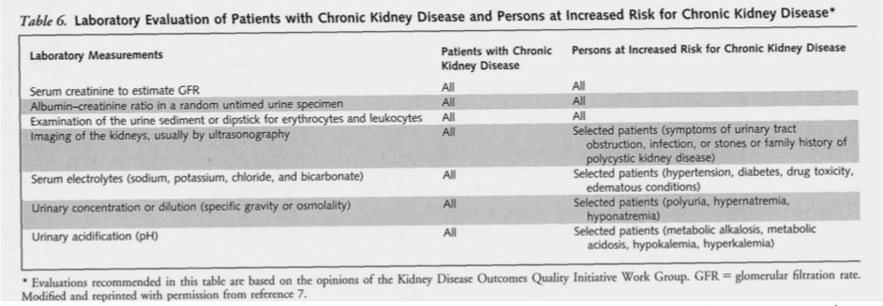
DIAGNOSTIC

Slide 25
DIAGNOSTIC
Elektrolit
: hiperkalemia atau hipokalemia,
D
hiponatremia, hiperkloremia atau hipokloremia, hiperfosfatemia, hipokalemia
: Hb menurun, asam urat
: ukuran ginjal yang mengecil, korteks
D
Hematologi
D
USG Ginjal
yang menipis, adanya hidronefrosis atau batu ginjal, kista, massa, kalsifikasi.

Slide 26
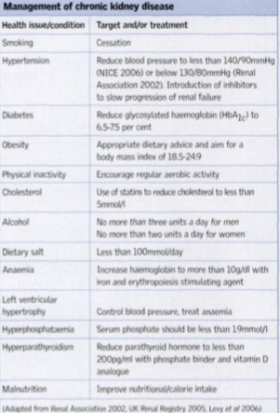
MANAGEMENT

Slide 27
PENATALAKSANAAN
D Terapi spesfik yang mendasarinya
D Pencegahan terapi terhadap kondisi komorbid
D Memperlambat fungsi ginjal
D Pencegahan dan terapi terhadap komplikasi
D Pencegahan dan terapi penyakit kardiovaskuler
D Terapi pengganti ginjal

Slide 28

MASALAH KEPERAWATAN, INTERVENSI DAN EVALUASI

Slide 29
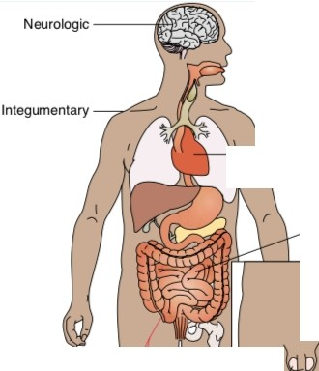

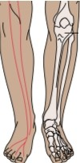
Signs and Symptoms of Chronic Renal Failure
Neurologic
Weakness and futigue; confusion; inability to concentrate; disorienta­
tion; tremors; seizures; asterixis; restlessness of legs; burning of soles of feet; behavior changes
Integumentary
Gray-bronzeskin color; dry, flakyskin; prurirus; ecchymosis; purpura; thin, brittle nails; coarse, thinning hair
Cardiovascular
Hypertension; pitting edema {feet, hands, sacrum); periorbital edema; pericardia) friction rub; engorged neck veins; pericacditis; pericardia) ef­ fusion; pericardia) tamponade; hyperkalemia; hyperlipidemia
Pulmonary
Crackles; thick, tenacious sputum; depressed cough reflex; pleuritic
pain;shortness ofbreath; tachypnea; Kussmaul-type respirations; ure­ mic pneumonitis; "uremic lung"
Gastrointestinal
Ammonia odor to breath {"uremic fetor"); metallic taste; mouth ul­ cerations and bleeding; anorexia, nausea, and vomiting; hiccups; con­ stipation or diarrhea; bleeding from gastrointestinal tract
Hematologic
Anemia; thrombocytopenia
Reproductive
Amenorrhea; testicular atrophy; infertility; decreased libido
Musculoskeletal
Muscle cramps; loss of muscle strength; renal osteodystrophy; bone pain; bone fractures; foot drop
->,-+c-1---
Cardiovascular
Pulmonary
r---""'ui.
-1-----''t---
Gastrointestinal
Hematologic ,_
'---Reproductive
-----Musculoskeletal

Slide 30
NURSING PROBLEMS
D Excess fluid volume related to decreased urine output, dietary excesses, and retention of sodium and water
D Imbalanced nutrition: less than body requirements related to anorexia, nausea and vomiting, dietary restrictions, and altered oral mucous membranes
D Deficient knowledge regarding condition and treatment regimen
D Activity intolerance related to fatigue, anemia, retention of waste products, and dialysis procedure
D Low self-esteem related to dependency, role changes, changes in body image, and sexual dysfunction
D Etc

Slide 31
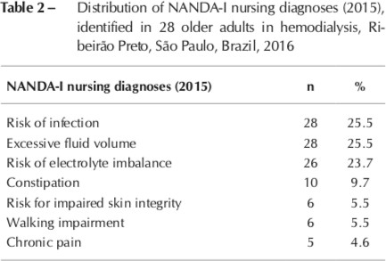
NURSING PROBLEMS

Slide 32
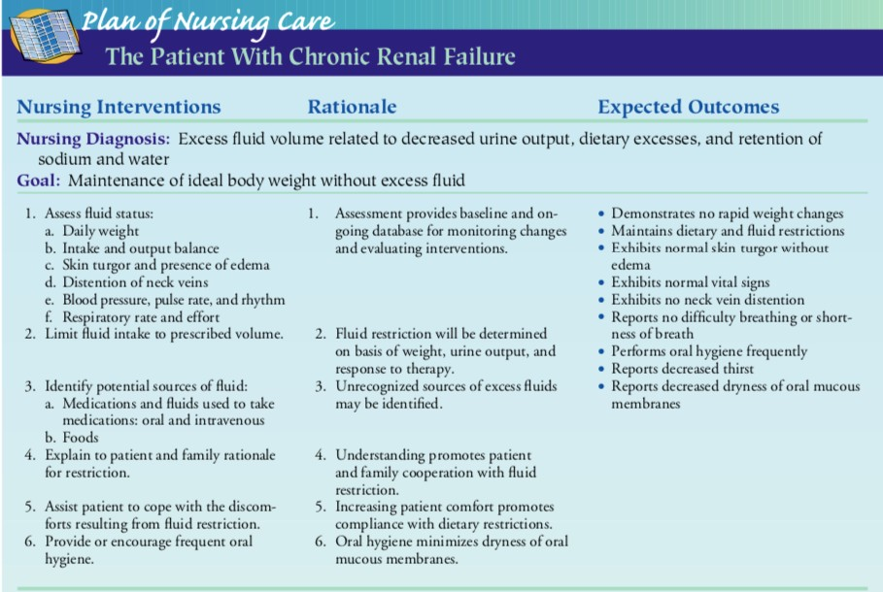

Slide 33
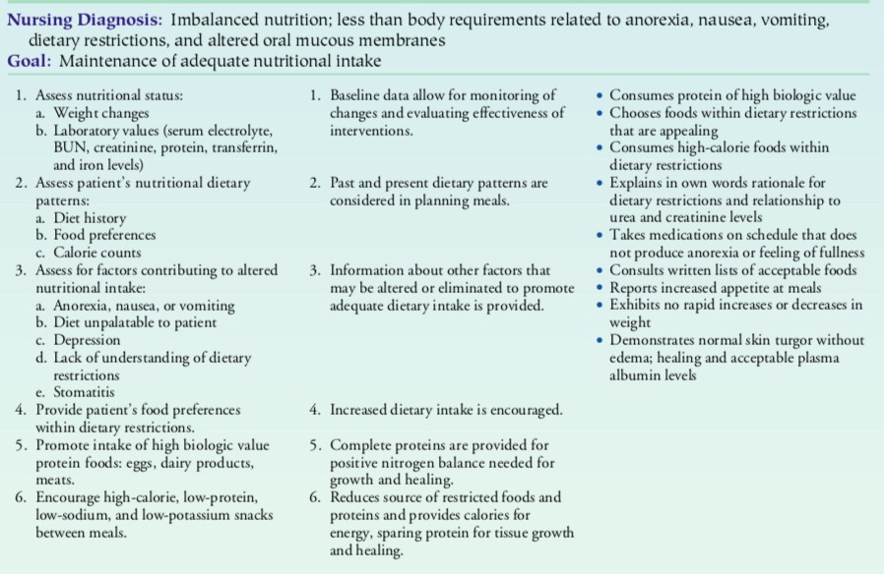

Slide 34
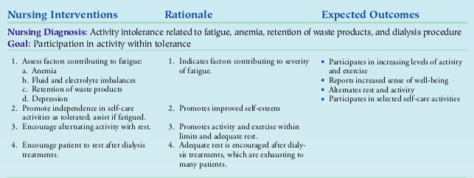

Slide 35
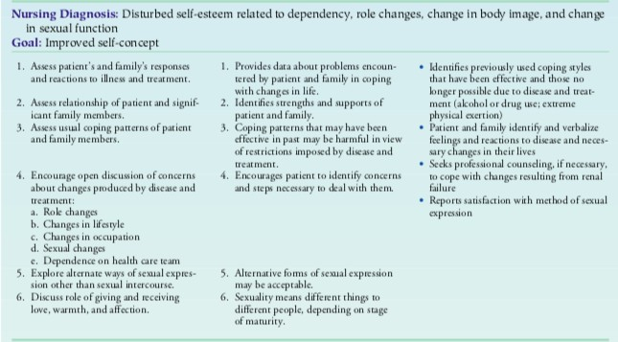

Slide 36
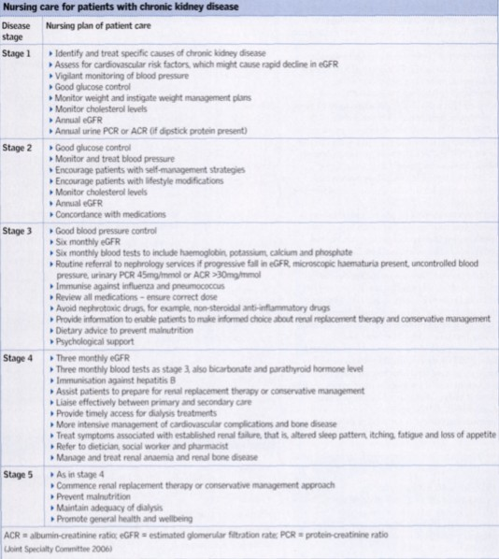
INTERVENSI

Slide 37
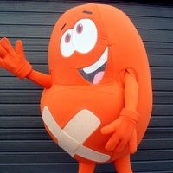
TERIMA KASIH

