Slide 1
Proses pembentukan urin

Slide 2
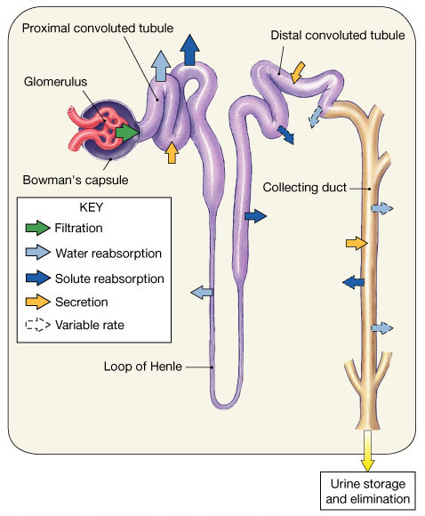
Proses pembentukan urine
Filtrasi Glomerular → cairan dan senyawa terlarut masuk ke kapsula bowman- lumen tubulus
Reabsorbsi Tubular → cairan dan senyawa terlarut kembali ke darah
Sekresi tubular → cairan dan senyawa terlarut masuk ke lumen tubulus
Keseimbangan
jumlah yang dieksresi dalam urine = jumlah yang difiltrasi oleh glomerulus – jumlah yang direabsorbsi ke dalam kapiler + jumlah sekresi tubulus

Slide 3
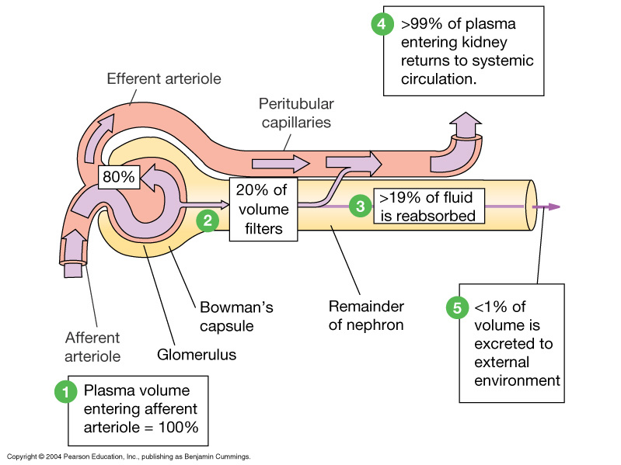
Ekskresi :
Semua senyawa yang difiltrasi dan disekresi yang tidak direabsorbsi kembali
Membuang kelebihan ion, H2O, molekul, toxin, urea, “molekul asing"
Ginjal →Ureter → Kandung Kemih (vesica urinaria)→ uretra→ ke luar tubuh

Slide 4
Komposisi filtrat glomerulus
Komposisi Filtrat glomerulus = konsentrasi plasma darah (konsentrasi garam dan molekul organik : glukosa, asam amino) kecuali protein (bebas protein)
Filtrasi glomerulus dibatasi oleh besar molekul dan muatan molekul
Zat terlarut netral :
  Zat dengan radius < 180 nanometer difiltrasi secara bebas
  Zat > 360 nm tidak dapat difiltrasi
  Zat antara 180 dan 360 nm mengalami difiltrasi (jumlah tertentu)

Slide 5
Reabsorpsi dan sekresi
Mekanisme transport : difusi, osmosis, transport aktiv dan terfasilitasi
Protein pembawa (Carrier) mempunyai kemampuan transport maximum (T_{m}) → menentukan kemampuan reabsorbsi senyawa dalam ultrafiltrat dari tubulus
Suatu transport maximum (T_{m}):
  Menggambarkan jumlah pembawa yang tersedia di tubulus ginjal

Slide 6
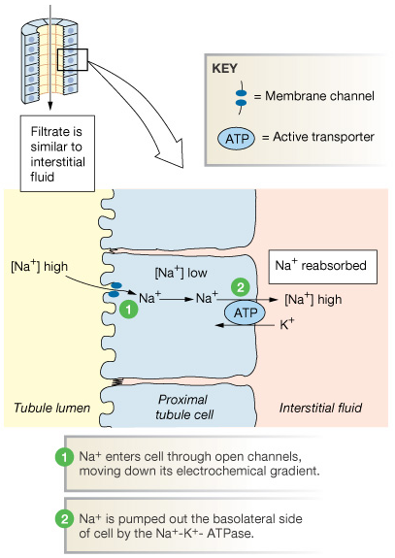
Reabsorbsi Na+ : Primer : Transport Aktif
Reabsorpsi Na (Sodium) hampir selalu dengan transport aktif : Na⁺-K⁺ ATPase pump
Reabsorbsi Na⁺ memberikan energi untuk reabsorbsi senyawa terlarut lainnya
  Air melalui osmosis
  Senyawa organik beberapa Kation melalui transport aktiv sekunder

Slide 7
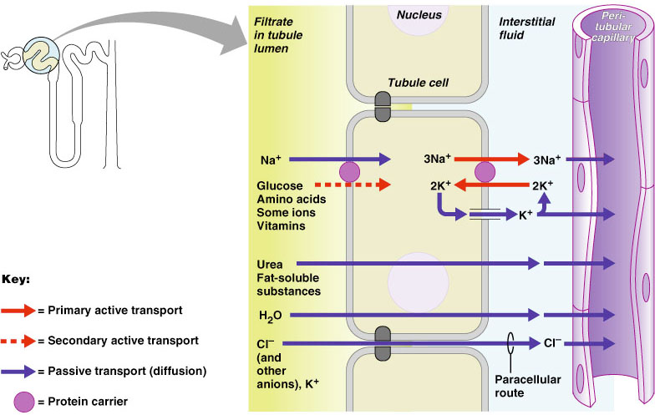
Transport aktif melalui Na+/K+ Pump
Figure 25.12

Slide 8
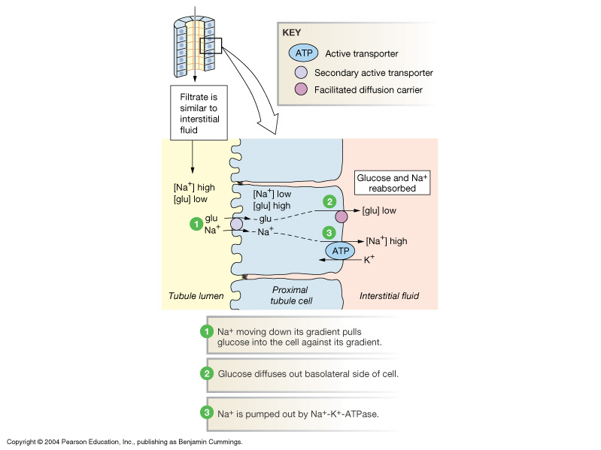
Transport aktif sekunder / Cotransport
Na⁺ linked secondary active transport
Tempat utama : Tubulus Contortus proximal
Reabsobsi dari :
  Glucose
  Ion-ion
  Asam Amino
Sodium-linked glucose reabsorption in the proximal tubule

Slide 9
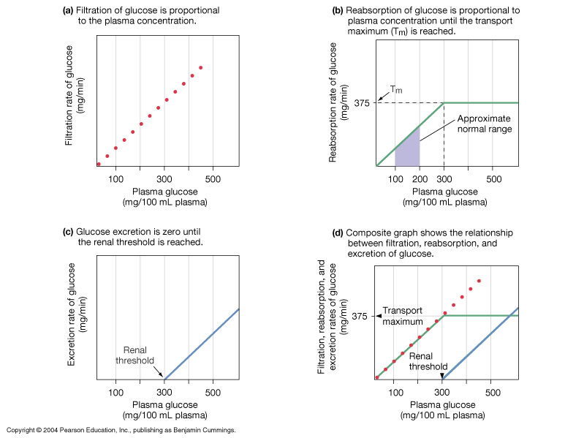
Reabsorbsi : Transport Maksimum
Glucose handling by the nephron

Slide 10
Senyawa yang tidak bisa direabsorbsi
Suatu senyawa tidak bisa direabsorbsi jika : :
  Tidak ada protein transport untuk rabsosrbsi
  Tidak larut lemak
  Ukuran terlalu besar untuk melewati pori-pori membran
kreatinin dan asam urat adalah senyawa yang paling penting yang tidak dapat direabsorbsi → digunakan untuk menilai fungsi filtrasi ginjal

Slide 11
Sekresi Tubular
Sekresi tubulus penting untuk: :
  Membuang senyawa yang tidak dapat dibuang melalui filtrasi glomerulus
  Membuang senyawa yang tidak diperlukan oleh tubuh seperti urea dan asam urat
  Membuang kelebihan ion potassium (K)
  Mengontrol pH darah

Slide 12
Reabsorbsi dan Sekresi di PCT
Filtrasi glomerulus menghasilkan cairan ultrafiltrat yang mirip seperti cairan plasma tetapi tanpa protein albumin
pada PCT terjadi reabsorbsi ultrafiltrat sampai 60-70%
  Na (Sodium), semua nutrien, kation, anion (HCO₃⁻), dan air
  Senyawa yang larut lemak
  Asam amino
Sekresi ion H+ → fungsi pengontrolan pH darah

Slide 13
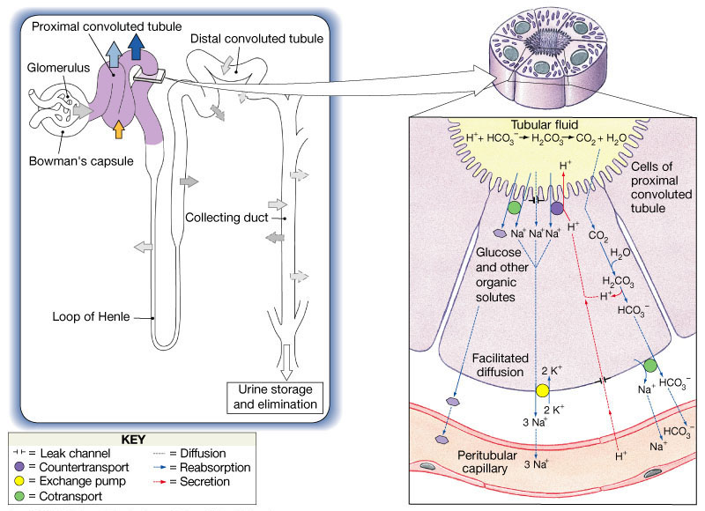
Proses Transpor di PCT
Figure 26.12

Slide 14
Reabsorbsi dan Sekresi di DCT
DCT dan tubulus kolektivus → proses akhir dalam pembetukan urin
Reabsorbsi dan sekresi aktif pada DCT
  Absorbsi Na⁺ dan Cl⁻
  Sekresi K+ dan H+ → pengontrolan pH darah
Reabsorbsi air di DCT dikontrol oleh hormon ADH (vasopressin)
Reabsorbsi dan sekresi Na+, K+ dikontrol oleh hormon aldosteron

Slide 15
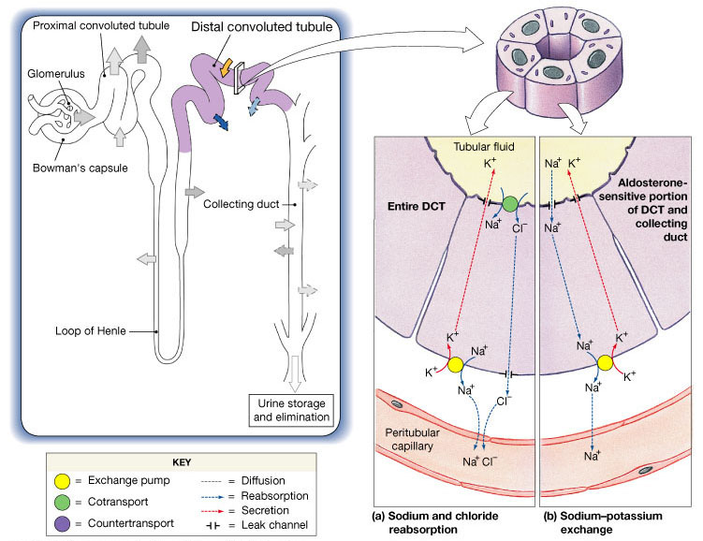
Reabsorbsi dan sekresi tubulus di DCT

Slide 16
3 Proses di DCT
Sekresi aktif ion-ion, asam, obat dan toksin
Reabsorbsi selektif ion sodium (Na) dan calcium
Reabsorbsi selektif air → menentukan kepekatan urin

Slide 17
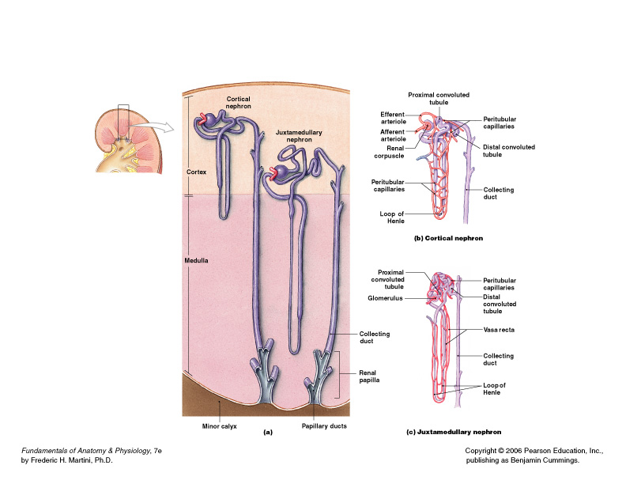
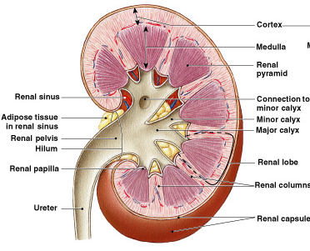
Sistem kolektivus (duktus dan tubulus koletivus)
Menerima cairan dari DCT
Dari setiap nefron → bermuara ke duktus koletivus terdekat
Beberapa duktus kolektivus:
  Bermuara ke duktus papillary → menuju ke → calix minor

Slide 18
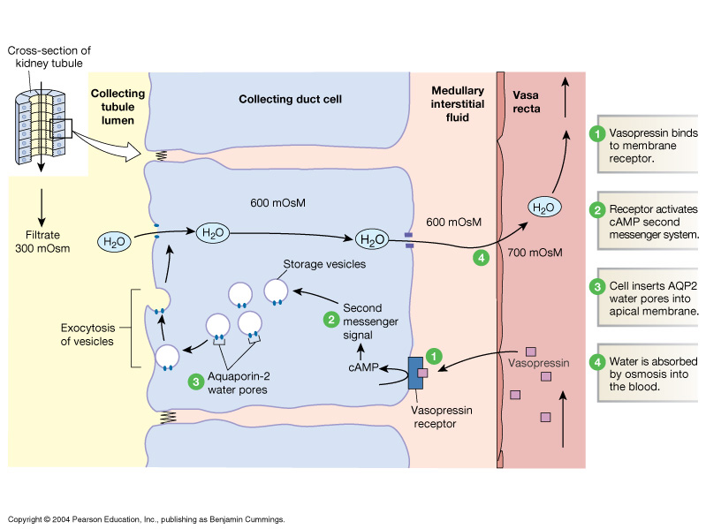
Mekanisme kerja ADH (Vasopressin): membentuk pori air
Pada sebagian DCT dan tubulus kolektivus → terjadi reabsorbsi air yang tergantung ADH (ADH-dependent) → disebut reabsorbsi air fakultatif
Figure 20-6: The mechanism of action of vasopressin

Slide 19
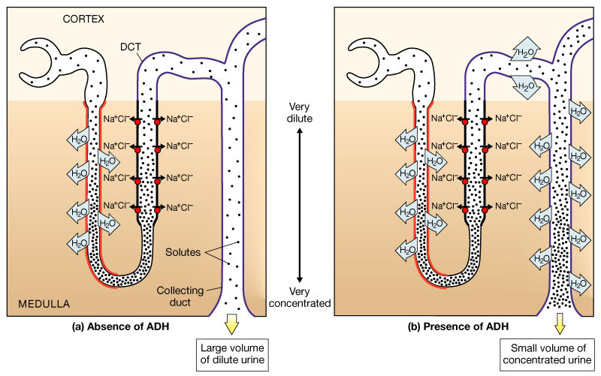
Effek ADH pada DCT dan tubulus kolektivus
Figure 26.15a, b

Slide 20
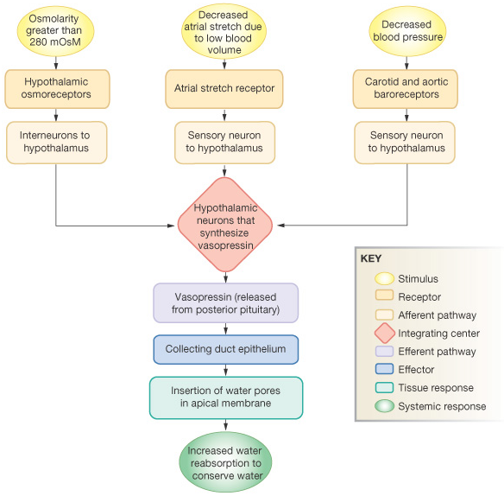
Refleks keseimbangan air : diatur melalui pelepasan ADH (Vasopressin)

Slide 21
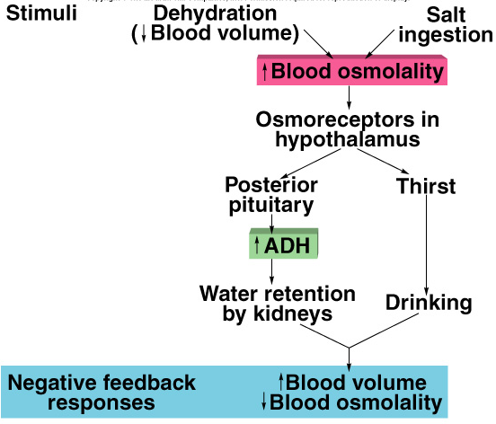
Regulasi oleh ADH
Dilepaskan oleh hipofisis posterior ketika osmoreceptor mendeteksi peningkatan osmolaritas plasma
Dehidrasi atau asupan garam (Na) yang tinggi :
  Merangsang rasa haus
  Menstimulasi reabsorsi air dari ultrafiltrat urine

Slide 22
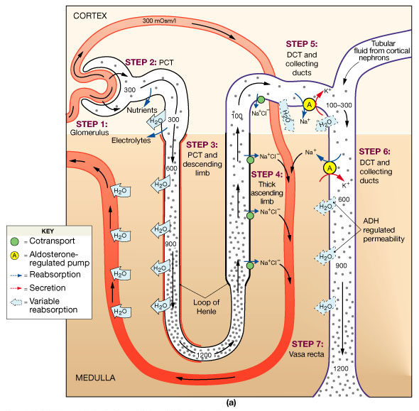
Ringkasan : Fungsi Ginjal
Figure 26.16a

Slide 23
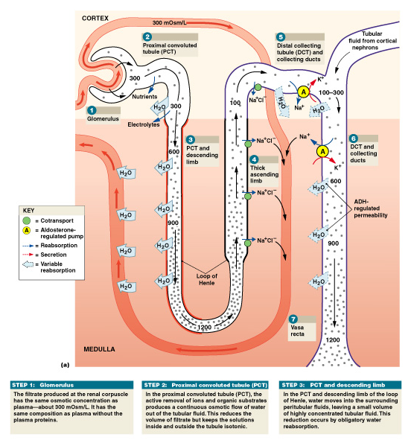
Step 1: Glomerulus
Melalui proses filtrasi → Menghasilkan Filtrat dengan komposisi mirip plasma kecuali tidak mengandung protein

Slide 24
Step 2: Proximal Convoluted Tubule (PCT)
Secara aktif mentranspor ion dan senyawa organik :
  Menghasilkan tekanan osmotik tertentu pada cairan tubulus → mengontrol aliran keluar air dari tubulus
  Mengurangi volume cairan ultrafiltrat
  Menjaga cairan dalam tubulus dan di luar tubulus isotonic

Slide 25
Step 3: PCT dan Loop of Henle pars Descenden
Air direbasorbsi → menghasilkan cairan ultrafiltrat dengan konsentrasi tinggi (pekat)
Mengurangi volume ultrafiltrat

Slide 26
Step 4: Loop of henle pars Ascenden
Sel-sel tubulus secara aktif mereabsorbsi Na⁺ and Cl—
Tekanan osmotik terutama ditentukan oleh kadar urea

Slide 27
Step 5: DCT dan Tubulus kolektivus
Bagian terakhir proses penetuan komposisi dan volume urin
Tekanan Osmotik ditentukan melalui transport aktif Na dan K
ADH (vasopresin) dan aldosteron mengontrol proses transport di bagian ini

Slide 28
Step 6: Vasa Recta
Mengabsorbsi air dan senyawa yang terlarut di tubulus ke dalam sirkulasi sistemik
Menjaga gradien konsentrasi di medulla ginjal

Slide 29
Transport, penampungan dan ekskresi urin

Slide 30
Transport, penampungan dan ekskresi urin
Terjadi pada traktus urinarius:
  ureter
  Vesika urinarius
  uretra

Slide 31
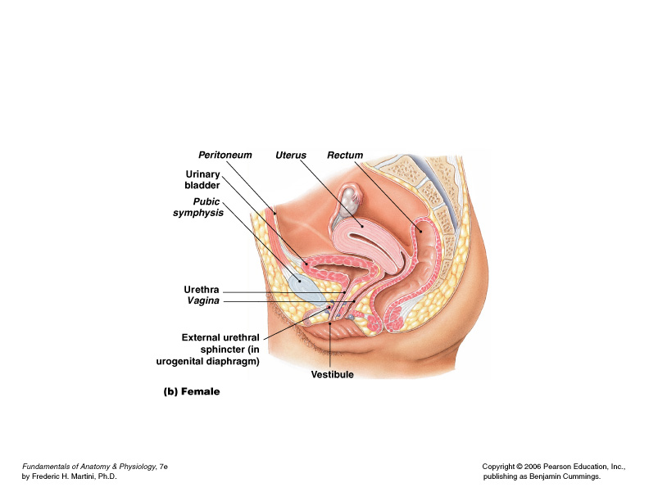
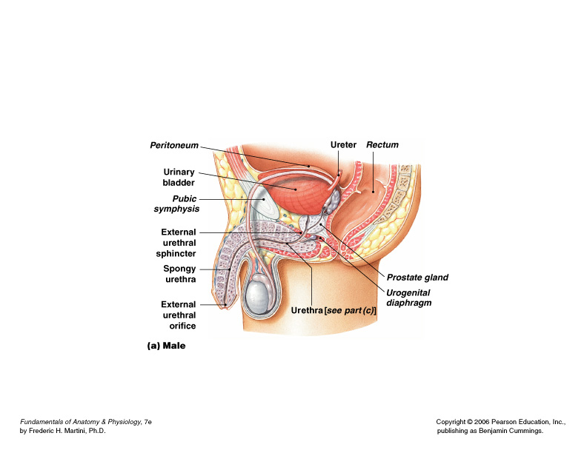
Organ yang terlibat dalam proses transport dan penampung urin

Slide 32
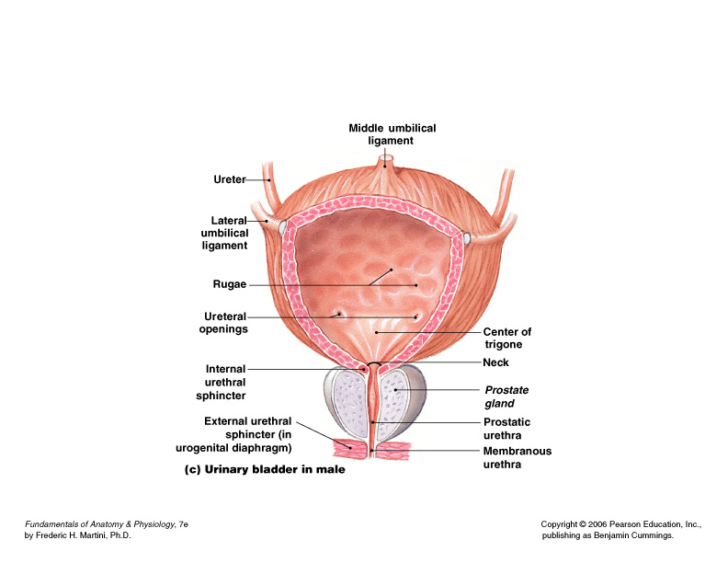
Organ yang terlibat dalam proses transport dan penampung urin
Figure 26–18c
Notes:
v

Slide 33
Ureter

Slide 34
Kontraksi peristaltik ureter
Dimulai dari pelvis renalis
Berlanjut disepanjang ureter
Fmemompa urine ke vesika urinarius
Kontraksi terjadi setiap 30 detik
Urin mengalir masuk ke vesika urinarius setiap 10-15 detik

Slide 35
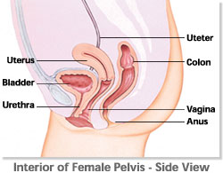
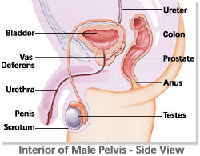
Vesika urinarius

Slide 36
Pada dinding vesika urinarius terdapat muskulus detrusor → kontraksinya mendorong urin keluar ke urethra
Pada bagian bawah terdapat spinkter uretra interna → mengatur pengaliran urin ke uretra

Slide 37
Uretra :
3 bagian uretra laki-laki
Uretra pars Prostatic:
  Uretra yang menembus kelenjar prostat
Uretra pars Membranosa:
  Uretra yang melewati diafragma urogenital
Uretra pars spongiosa (penile urethra):
  Uretra yang terdapat dalam batang penis

Slide 39
Urin

Slide 40
Sifat fisika Urine
Warna dan kejernihan
  Jernih, warna kuning tua
  Urin yang pekat, warnya lebih tua
  Obat, vitamin dan diet dapat mengubah warna urin
pH
  Sedikit asam (pH 6), kisaran pH 4-5 sampai 7- 8.0
  Diet dapat mempengaruhi pH
Berat jenis
  1.001 - 1.035
  Tergantung pada konsentrasi senyawa yang terlarut

Slide 41
Sifat kimia Urine
Urine terdiri dari 95% water dan 5% senyawa terlarut
Mengandung sampah nitrogen seperti urea, asam urat dan kreatinin
Senyawa terlarut lain yang normal ditemukan dalam urin : :
  Ion Sodium, potassium, phosphate, dan sulfate
  Ion Calcium, magnesium, dan bicarbonate

Slide 42
Miksi

Slide 43
Micturition
From the kidneys urine flows down the ureters to the bladder propelled by peristaltic contraction of smooth muscle.
The bladder is a balloon-like bag of smooth muscle = detrussor muscle → contraction of which empties bladder during micturition.
Pressure-Volume curve of the bladder has a characteristic shape.
There is a long flat segment as the initial increments of urine enter the bladder and then a sudden sharp rise as the micturition reflex is triggered.

Slide 44
Normal Micturition - Physiology
2 phases
  Filling and emptying
Normal micturition cycle requires that the urinary bladder and the urethral sphincter work together as a coordinated unit to store and empty urine
  Storage
    Bladder is a low-pressure receptacle
    Urinary sphincter – closed with high resistance to urinary flow
  Emptying
    Bladder contracts to expel urine
    Urinary sphincter – opens to allow urinary flow

Slide 45
Normal Micturition - Physiology
Filling phase
  Bladder
    Accumulates increasing volumes of urine
    Pressure inside the bladder remains low
    Pressure within the bladder must be < than the urethral pressure during the filling phase
  Bladder filling dependent on
    Intrinsic viscoelastic properties of the bladder
    Inhibition of the parasympathetic nerves
  Bladder filling primarily is a passive or active event?

Slide 46
Normal Micturition - Physiology
Bladder filling
  Sympathetic nerves also facilitate urine storage
    Inhibition of the parasympathetic nerves from triggering bladder contractions
    Directly cause relaxation and expansion of the detrusor muscle.
    Close the bladder neck by constricting the internal urethral sphincter
  Thus, sympathetic input to the lower urinary tract is constantly active during bladder filling.

Slide 47
Normal Micturition
During bladder filling - pudendal nerve becomes excited.
  Pudendal nerve stimulation → contraction of the external urethral sphincter
  Urethral pressure maintained by the continence mechanism, which is composed of ??
    Contraction of the external sphincter
    Contraction of the internal sphincter
Pressure gradients
  Continence = urethral pressure > or < bladder pressure
  Incontinence = urethral pressure < or > intravesical pressure is abnormally high

Slide 48
Normal Micturition - Physiology
Pressure Gradients
  During bladder filling –
    Small ↑ in intravesical pressure
    When the urethral sphincter is closed, the intraurethral pressure > the intravesical pressure
  With ↑ intraabdominal pressure (cough, sneeze, laugh, physical activity), some pressure transmitted to both the bladder and urethra
    If the pressure is evenly transmitted to both the bladder and urethra, Ø incontinence
    If pressure transmitted to the bladder is > urethra, stress incontinence results

Slide 49
Normal Micturition - Emptying
Involuntary (reflex) or voluntary
  Infants involuntarily reflex void when the volume of urine exceeds the voiding threshold
    Bladder wall stretch receptors → sacral cord → pudendal nerve →
      relaxation of the levator ani →relaxation of pelvic floor muscle
      Opens external sphincter
    Also, sympathetic nerves → relaxation of internal sphincter
    Parasympathetic nerves → detrusor contraction
    Bladder pressure > urethral pressure → urinary flow

Slide 50
Normal Micturition - Emptying
A repetitious cycle of bladder filling and emptying occurs in newborn infants
As the infant brain develops, the PMC also matures and gradually assumes voiding control
  During childhood, primitive voiding reflex becomes suppressed and the brain dominates bladder function
    Toilet training usually is successful at age 2-4 years
    Primitive voiding reflex may reappear in people with SCI

Slide 51
Delayed/Voluntary Voiding
Healthy adults are aware of bladder filling and can willfully initiate or delay voiding
Normally, the PMC functions as an on-off switch that is activated by stretch receptors in the bladder wall and is modulated by inhibitory and excitatory neurologic influences from the brain.
When voiding must be delayed
  Brain bombards the PMC with inhibitory signals to prevent detrusor contractions
  Individual actively contracts the levator muscles to keep the external sphincter closed

Slide 52
Normal Micturition – Delayed Emptying
Voiding = coordination of both the ANS and somatic nervous system, which are in turn controlled by the PMC located in the brainstem and regulated by the brain

Slide 53
Normal Micturition – Delayed Emptying
Voiding = coordination of both the ANS and somatic nervous system, which are in turn controlled by the PMC located in the brainstem and regulated by the brain

Slide 54
Pressure-volume graph for normal human bladder
1.25
1.00
Pressure (kPa)
Discomfort
Sense of urgency
0.75
1st desire to empty bladder
0.50
0.25
100
200
300
400
Volume (ml)

Slide 55
Micturition (Voiding or Urination)
Bladder can hold 250 - 400ml
Greater volumes stretch bladder walls initiates micturation reflex:
Spinal reflex
  Parasympathetic stimulation causes bladder to contract
  Internal sphincter opens
  External sphincter relaxes due to inhibition

Slide 56
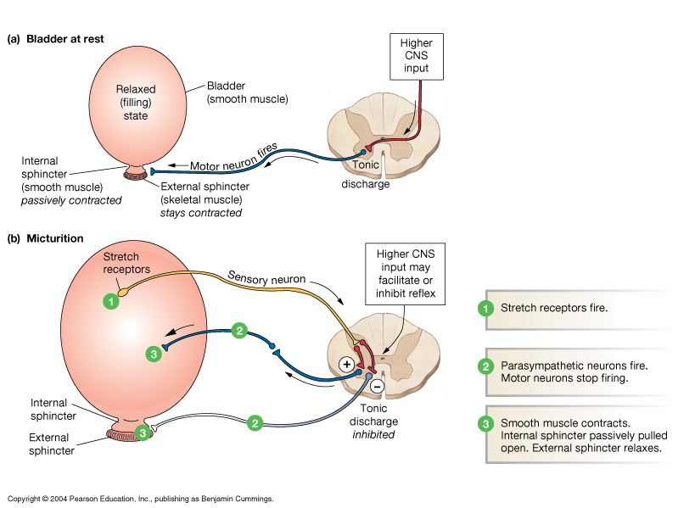
Urination: Micturation reflex
Figure 19-18: The micturition reflex

Slide 57
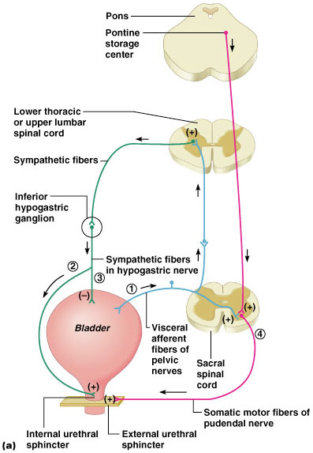
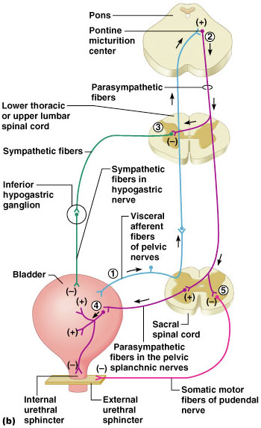
Micturition (Voiding or Urination)
Figure 25.20a, b

Slide 58
Regulasi asam basa

Slide 59
Maintaining Acid-Base Balance in Blood
Blood pH must remain between 7.35 and 7.45 to maintain homeostasis
  Alkalosis – pH above 7.45
  Acidosis – pH below 7.35
Most ions originate as byproducts of cellular metabolism
Copyright © 2003 Pearson Education, Inc. publishing as Benjamin Cummings
Slide 15.33a

Slide 60
Blood Buffers
Molecules react to prevent dramatic changes in hydrogen ion (H⁺) concentrations
  Bind to H⁺ when pH drops
  Release H⁺ when pH rises
Three major chemical buffer systems
  Bicarbonate buffer system
  Phosphate buffer system
  Protein buffer system
Copyright © 2003 Pearson Education, Inc. publishing as Benjamin Cummings
Slide 15.34

Slide 61
The Bicarbonate Buffer System
Mixture of carbonic acid (H₂CO₃) and sodium bicarbonate (NaHCO₃)
Bicarbonate ions (HCO₃–) react with strong acids to change them to weak acids
Carbonic acid dissociates in the presence of a strong base to form a weak base and water
Copyright © 2003 Pearson Education, Inc. publishing as Benjamin Cummings
Slide 15.35

Slide 62
Respiratory System Controls of Acid-Base Balance
Carbon dioxide in the blood is converted to bicarbonate ion and transported in the plasma
Increases in hydrogen ion concentration produces more carbonic acid
Excess hydrogen ion can be blown off with the release of carbon dioxide from the lungs
Respiratory rate can rise and fall depending on changing blood pH
Copyright © 2003 Pearson Education, Inc. publishing as Benjamin Cummings
Slide 15.36

Slide 63
Renal Mechanisms of Acid-Base Balance
Excrete bicarbonate ions if needed
Conserve or generate new bicarbonate ions if needed
Urine pH varies from 4.5 to 8.0
Copyright © 2003 Pearson Education, Inc. publishing as Benjamin Cummings
Slide 15.37

Slide 64
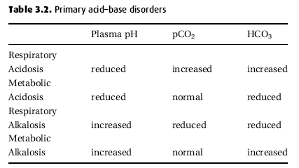

Slide 65
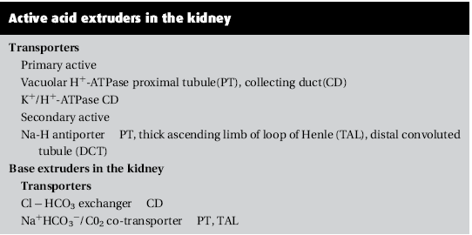

Slide 66
