Slide 1
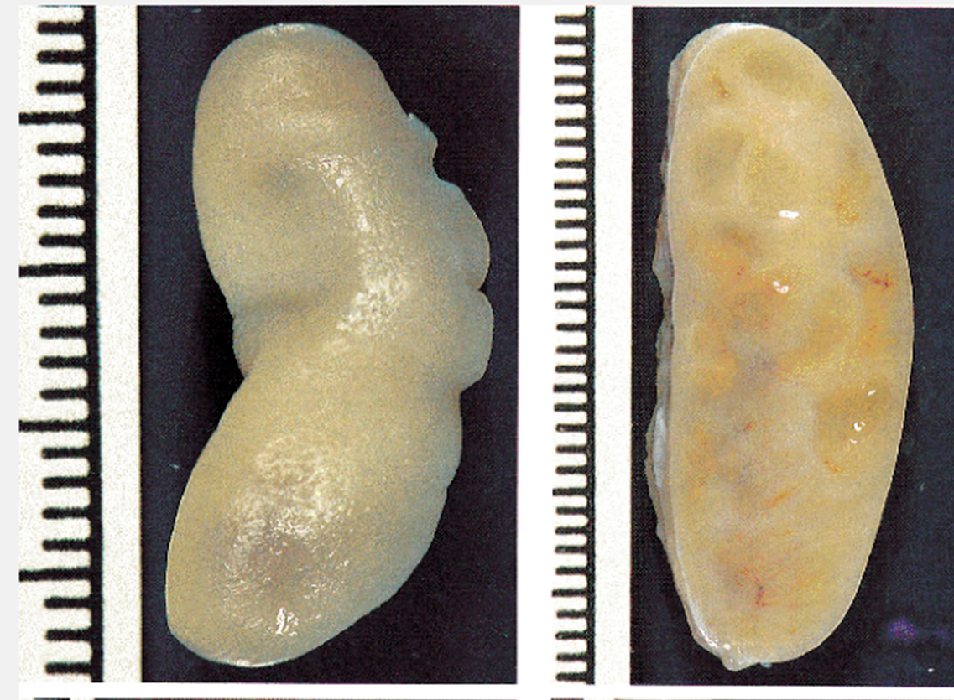
OVARIUM
Makroskopik
  Ukuran sekitar 4 × 2,5 × 1,5 cm
  Dibagi : korteks dan medula
  Korteks :
    lapisan sel stroma ditutup oleh aselular jaringan ikat kolagen aseluler tipis.
    Korteks luar : folikel dalam berbagai tahap pematangan
    Folikel → folikel Graafian → korpus luteum → korpus albicans
  Medula :
    jaringan mesenchymal longgar yg tersusun teratur dan sisa-sisa duktus mesonefrik (rete ovarii) serta kelompok kecil bulat-poligonal sel-sel epithelioid (sel hilus) di sekitar pembuluh dan saraf.
    Sel-sel hilus adalah sisa sisa gonad dari fase primitif "ambisexual” → sel yg memproduksi steroid dan menyerupai sel-sel interstitial testis. Menimbulkan masculinizing tumor (tumor sel hilar) → jarang

Slide 2
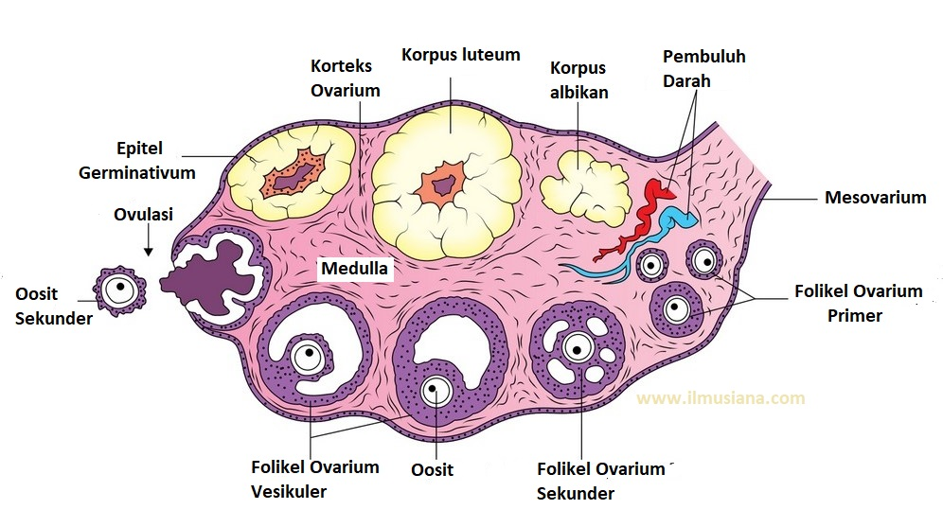

Slide 3
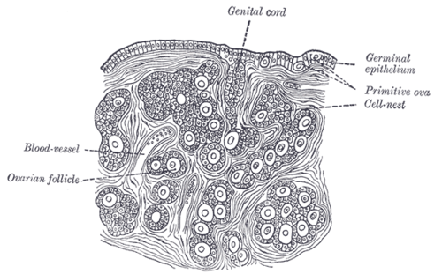
Kompartemen Histologis Utama
The Surface Müllerian Epithelium
The Germ Cells
The Sex Cord-Stromal Cells

Slide 4
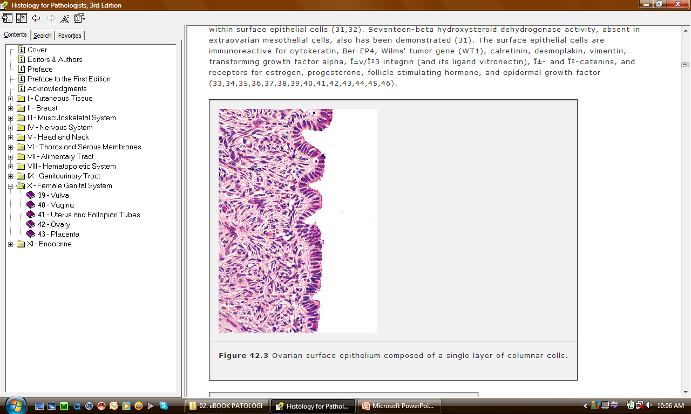
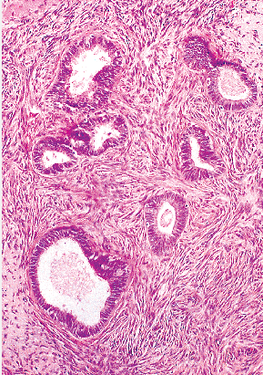
Epitel Ovarium
Epitel permukaan ovarium
Inklusi epitel kelenjar kortex ovarium

Slide 5
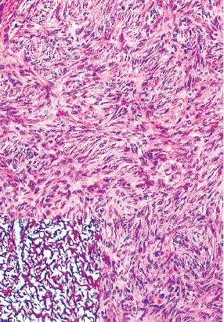
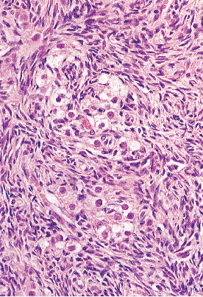
Stroma ovarium dibentuk oleh sel spindel tipe fibroblastik

Slide 6
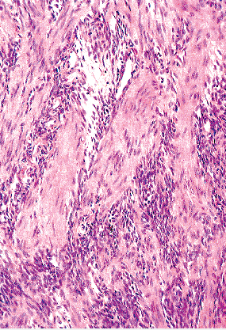
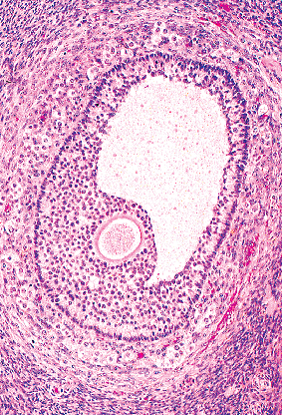
sel otot polos pd stroma ovarium
Folikel Matur

Slide 7
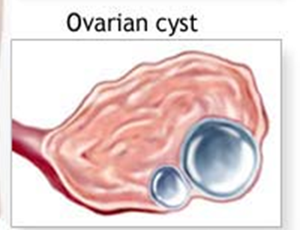
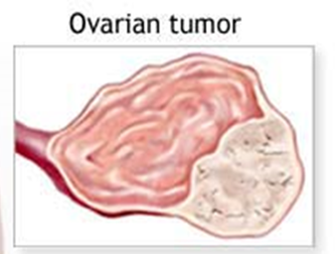
PATOLOGI OVARIUM
- NON NEOPLASIA DAN
KISTA FUNGSIONAL
- TUMOR OVARIUM

Slide 8
Follicle & Luteal Cysts
  Cystic follicle in the ovary are so common → normal
  Originate in :
    Unruptured graafian follicles
    Follicles that have ruptured & immediately sealed
  Morfologi
    Multiple
    Size: Ø 1-5 cm
    Clear-serous fluid, lined by a gray, glistening membran
    Larger cysts → pelvic pain

Slide 9
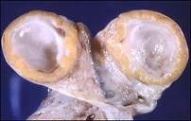
  Granulosa luteal cysts (corpora lutea) :
    Are normally present in the ovary
    Cysts are lined by a rim of bright yellow tissue containing luteinized granulosa cells
    Rupture → peritoneal reaction

Slide 10
Polycystic Ovaries (PCOD)
= Stein-Leventhal syndrome : 3-6% reproductive ♀
  Oligomenorrhea, anovulation, obesity, hirsutism, virilism
  Pathologic abnormality : cystic follicle >>
  Morfology :
    Size: twice normal size
    A thickened, fibrotic superficial cortex
    Innumerable follicle cysts
    Hyperplasia of the theca interna
    (follicular hyperthecosis)

Slide 11
Stromal Hyperthecosis
= Cortical stromal hyperplasia
  Commonly seen in postmenopausal women
  Characteristics : uniform enlargement of the ovary
  Bilateral
  Microscopically:
    hypercellular stroma
    luteinization of stromal cells
Theca Lutein Hyperplasia of Pregnancy
  Mimicking stromal hyperthecosis
  Proliferation of theca cells
  Expansion of the perifollicular zone

Slide 12
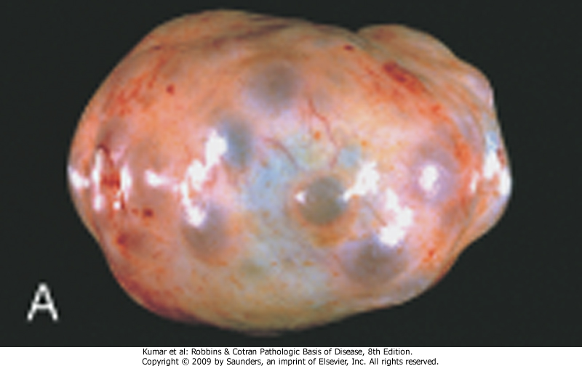
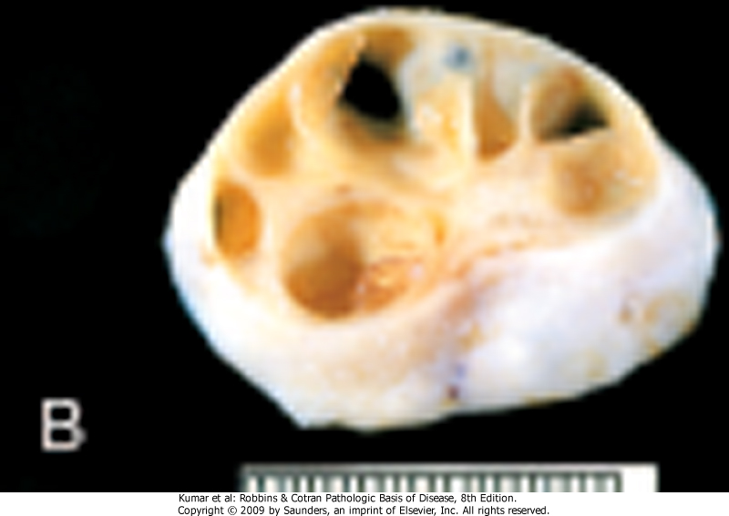
Polycystic Ovarian Disease
& Cortical Stromal Hyperplasia
The cortex ovarian reveals numerous clear cyst
Sectioning of the cortex reveals several subcortical cystic follicles

Slide 13
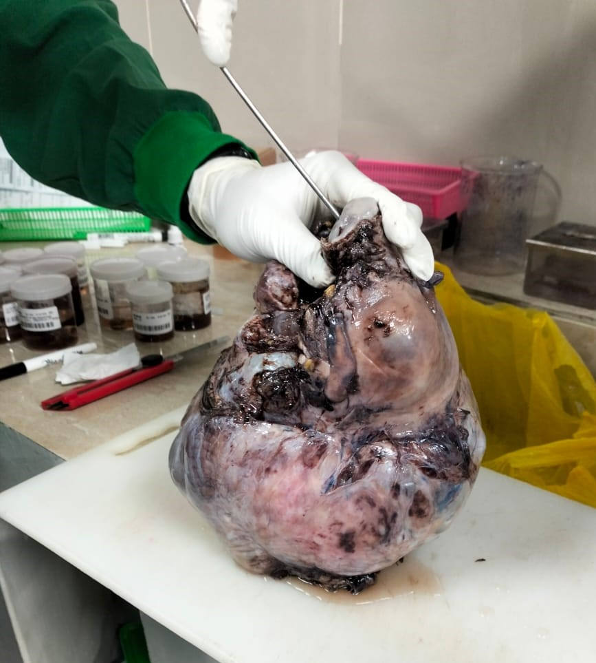
Neoplasma ovarium kistik permagna

Slide 14
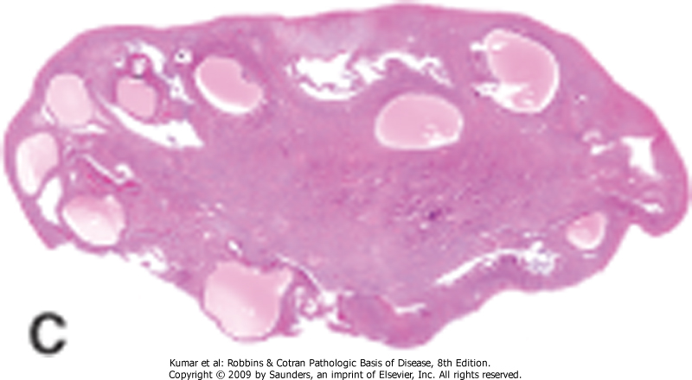
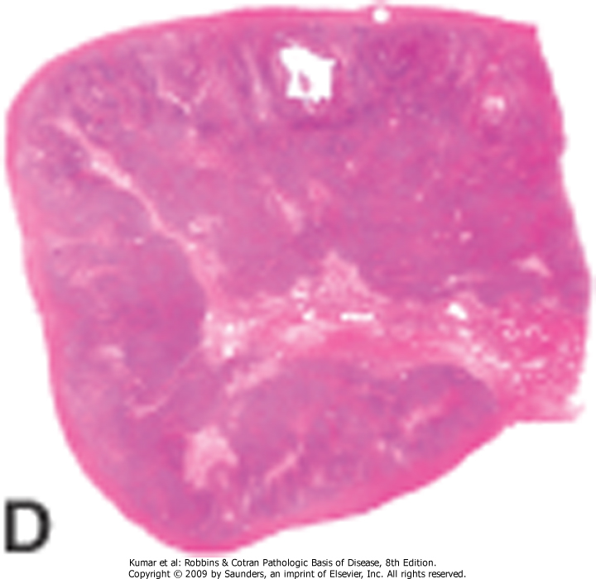
Polycystic Ovarian Disease
& Cortical Stromal Hyperplasia
Cystic follicles seen in a low-power microphotograph
Cortical stromal hyperplasia: diffuse stromal proliferation

Slide 15
Tumor Ovarium
Benign → 80% , terutama usia 20-45
Borderline → usia lebih tua
Malignant → biasanya pada ♀ 45-65 tahun
Pada penelitian Mieke dkk di RSUD Cengkareng insiden kanker ovarium terbanyak pada usia 51 – 60 tahun.
Asal → salah 1 dari 3 komponen ovarium :
  Tumors of Surface (Müllerian) Epithelium
  Germ Cell Tumor
  Sex Cord-Stromal Tumors

Slide 16
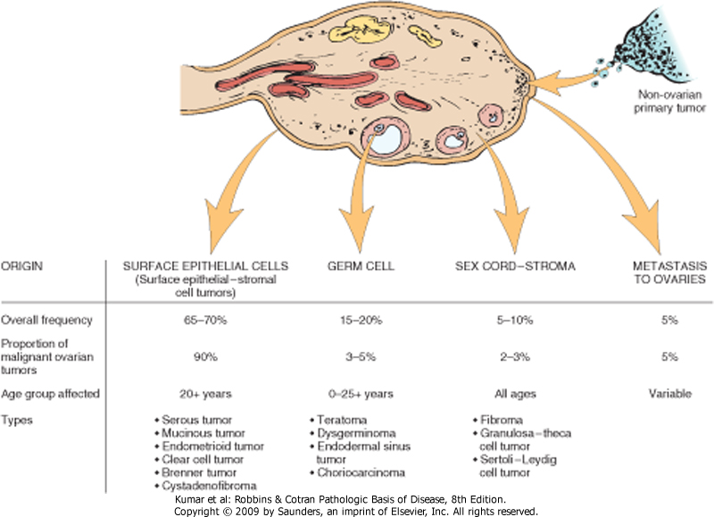
Pada penelitian Mieke dkk juga menunjukkan insiden terbanyak kanker ovarium berasal dari komponen epithelial yaitu sebanyak 95%, sedangkan dari komponen germ cell sebanyak 5%.

Slide 17
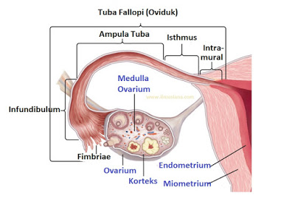
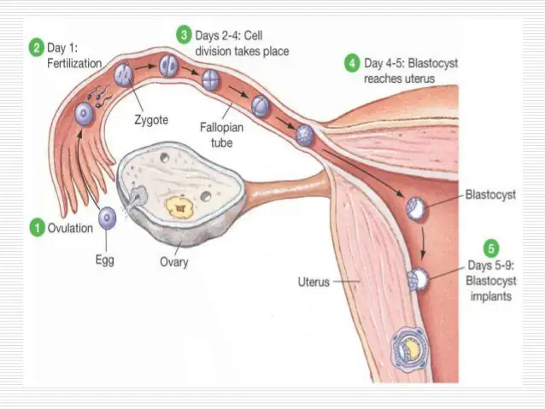
TUBA FALLOPI
  Epitel kuboid bersilia.

