Slide 1
Biochemistry Oncology
dr. Muhamad Dwi Putra, M.Biomed

Slide 2
OBJECTIVE
Necrosis vs Apoptosis
Apoptosis Mechanism
Cell cycle
CDK and Cyclin
Protooncogen vs Oncogenes
Tumor Supressor Genes
Carcinogen

Slide 3
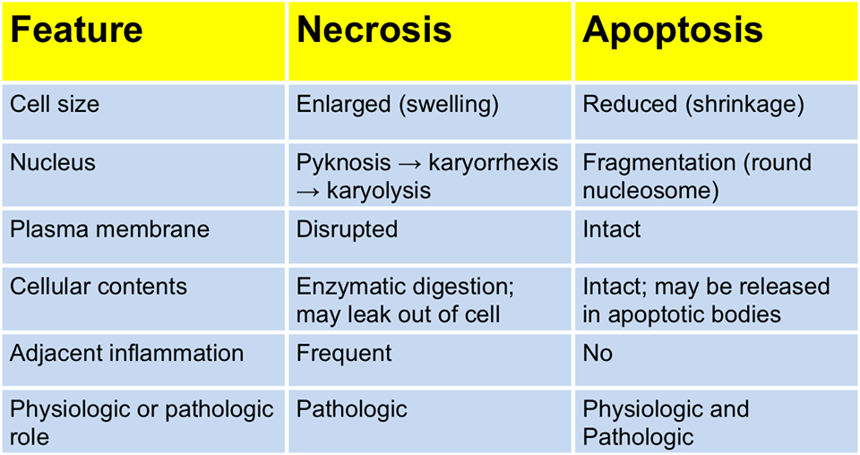
Necrosis vs Apoptosis

Slide 4
Apoptosis mechanism
Intrinsic Pathway
Extrinsic Pathway
Apoptosis Inducing Factor

Slide 5
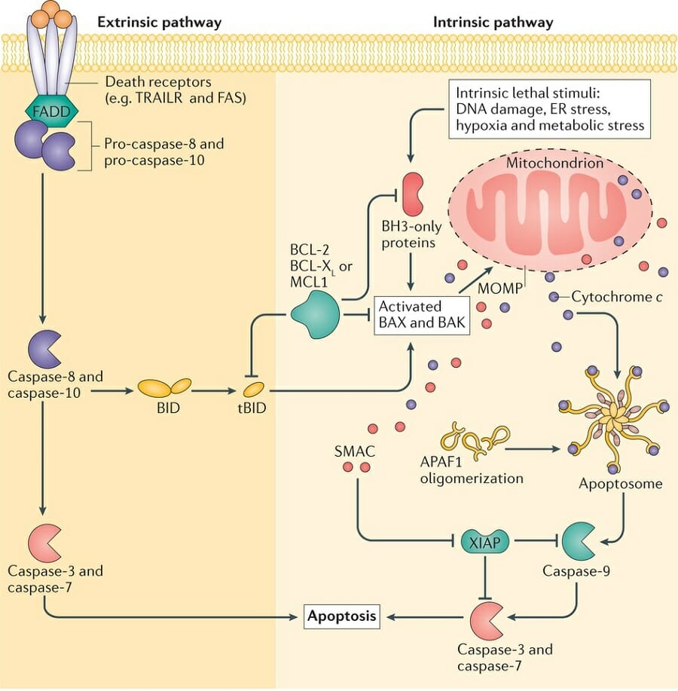
Intrinsic pathway
Intrinsic lethal stimuli
Produced BH3
Activated BAX and BAK (members of the Bcl-2 family and core regulators of the intrinsic pathway of apoptosis)
MOMP (Mithocondrial outer membran permeabilization)
Cythocrome C to cytoplasm
Apoptosome
Caspase 9

Slide 6
Intrinsic pathway
“The mitochondrial (or intrinsic) pathway is regulated by the BCL-2 family of proteins, named after the founding member, BCL-2, which was discovered as an oncogene in a B cell lymphoma and shown to inhibit apoptosis. Some members of this family are pro-apoptotic and others are anti-apoptotic. The pathway is initiated when cytoplasmic proteins of the BCL-2 family that belong to the BH3-only subfamily (so called because they contain one domain that is homologous to the third conserved domain of BCL-2) are induced or activated as a result of growth factor deprivation, noxious stimuli, DNA damage, or certain types of receptor-mediated signaling (e.g., strong signals delivered by self antigens in immature lymphocytes). BH3-only proteins are sensors of cell stress that bind to and influence death effectors and regulators. In lymphocytes, the most important of these sensors is a protein called BIM. Activated BIM binds to two pro-apoptotic effector proteins of the BCL-2 family called BAX and BAK, which oligomerize and insert into the outer mitochondrial membrane, leading to increased mitochondrial permeability. Growth factors and other survival signals induce the expression of anti-apoptotic members of the BCL-2 family, such as BCL-2 and BCL-XL, which function as inhibitors of apoptosis by blocking BAX and BAK and thus maintaining intact mitochondria. BH3-only proteins also antagonize BCL-2 and BCL-XL. When cells are deprived of survival signals, the mitochondria become leaky because of the actions of the BH3-only protein sensors and BAX and BAK effectors and the relative deficiency of anti-apoptotic proteins such as BCL-2 and BCL-XL. The result is that many mitochondrial components, including cytochrome c, leak out into the cytosol and activate cytosolic enzymes called caspases. Cytochrome c binds to a cytosolic protein called APAF-1, which then oligomerizes and activates procaspase-9, yielding active caspase-9. Caspase-9 in turn cleaves and thereby activates downstream caspases that induce nuclear DNA fragmentation and other changes that culminate in apoptotic death.”Excerpt FromCellular and Molecular ImmunologyAbul K. Abbas

Slide 7
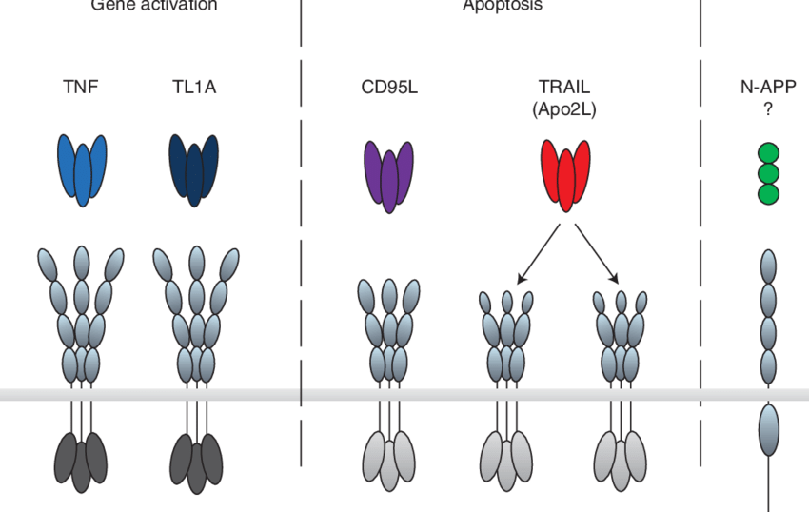
Extrinsic pathway
Outside stimuli
Death Receptor binding to Death Activator
Activating caspase 8
Walczak, Henning. (2013). Death Receptor-Ligand Systems in Cancer, Cell Death, and Inflammation. Cold Spring Harbor perspectives in biology. 5. 10.1101/cshperspect.a008698.

Slide 8
Extrinsic pathway
“In the death receptor (or extrinsic) pathway, cell surface receptors of the TNF receptor superfamily are engaged by their TNF superfamily ligands. The receptors oligomerize and activate cytoplasmic adaptor proteins, which assemble procaspase-8, which cleaves itself when oligomerized and produces active caspase-8. The active caspase-8 cleaves downstream caspases, again resulting in apoptosis. In T cells the most important death receptor is FAS (CD95), and its ligand is FAS ligand (FASL). FAS is a member of the TNF receptor family, and FASL is homologous to TNF. In many cell types, caspase-8 cleaves and activates a BH3-only protein called BID that binds to BAX and BAK and induces apoptosis via the mitochondrial pathway. Thus, the mitochondrial pathway may serve to amplify death receptor signaling.”Excerpt FromCellular and Molecular ImmunologyAbul K. Abbas

Slide 9
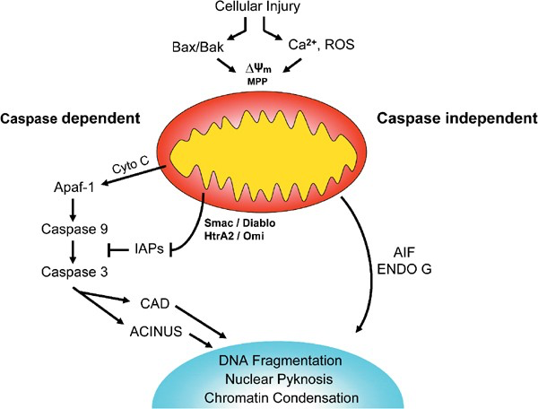
Apoptosis Inducing Factor (AIF)
Caspase Independent
Located in Intermembrane space mithocondria

Slide 10
Excerpt FromCellular and Molecular ImmunologyAbul K. Abbas

Slide 12
“In addition to ingesting microbes, macrophages ingest necrotic host cells, including cells that die in tissues because of the effects of toxins, trauma or interrupted blood supply, and neutrophils that die after accumulating at sites of infection. This is part of the cleaning-up process after infection or sterile tissue injury. Macrophages can specifically recognize and engulf cells that die by apoptosis before the dead cells can release their contents and induce inflammatory responses. This clearance by macrophages of apoptotic cells, including apoptotic neutrophils, is a process called efferocytosis. Throughout the body and throughout the life of an individual, unwanted cells die by apoptosis as part of many physiologic processes, such as development and renewal of healthy tissues and maintenance of cell numbers (tissue homeostasis), and the dead cells are eliminated by macrophages.”Excerpt FromCellular and Molecular ImmunologyAbul K. Abbas

Slide 13
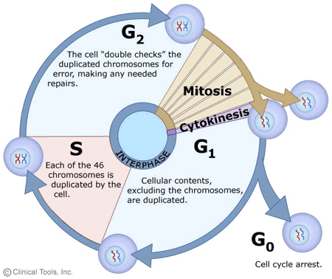
Cell Cycle

Slide 14
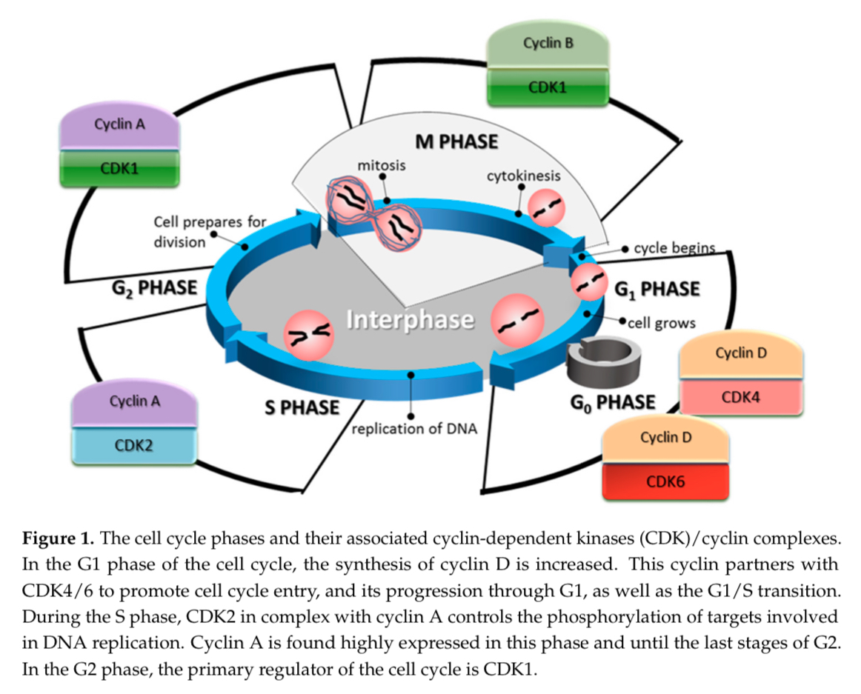
CDK ; Cyclin
García-Reyes, B.; Kretz, A.-L.; Ruff, J.-P.; Von Karstedt, S.; Hillenbrand, A.; Knippschild, U.; Henne-Bruns, D.; Lemke, J. The Emerging Role of Cyclin-Dependent Kinases (CDKs) in Pancreatic Ductal Adenocarcinoma. Int. J. Mol. Sci. 2018, 19, 3219. https://doi.org/10.3390/ijms19103219
Cyclin Dependent Kinase (CDK)

Slide 15
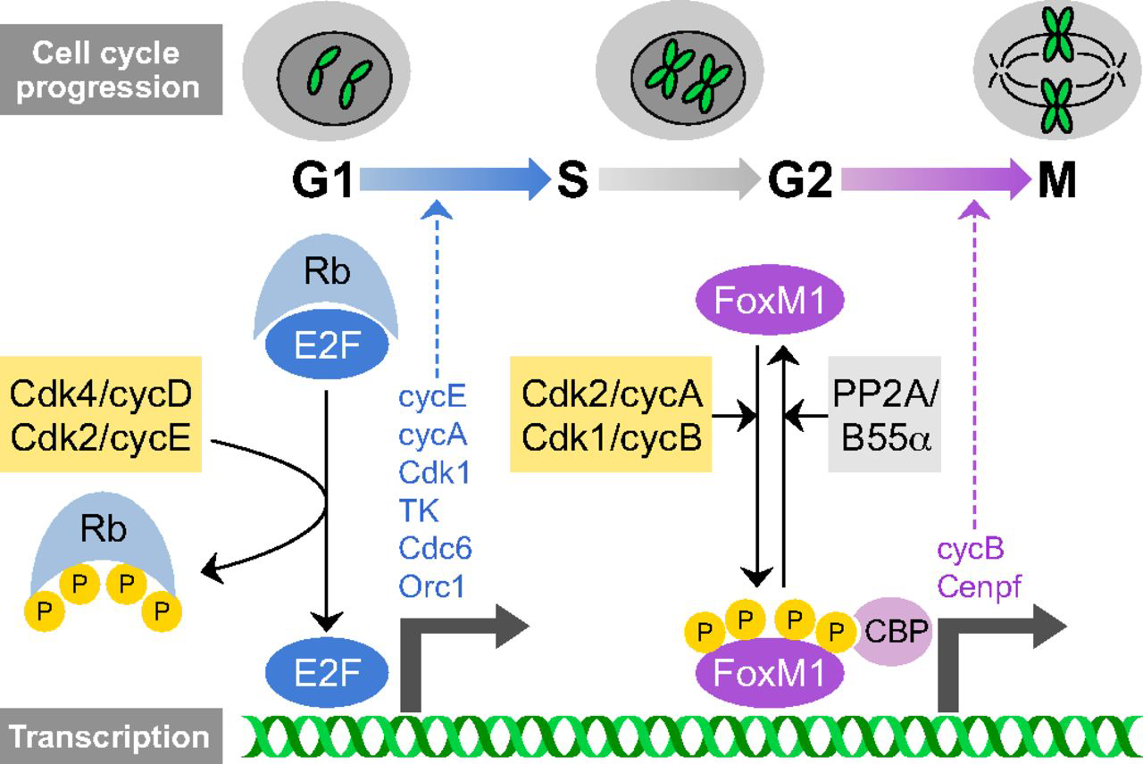

Slide 16
Proto-oncogen vs Oncogen
Proto-oncogenes are genes that normally help cells grow and divide to make new cells, or to help cells stay alive. When a proto-oncogene mutates (changes) or there are too many copies of it, it can become turned on (activated) when it is not supposed to be, at which point it's now called an oncogene.

Slide 18
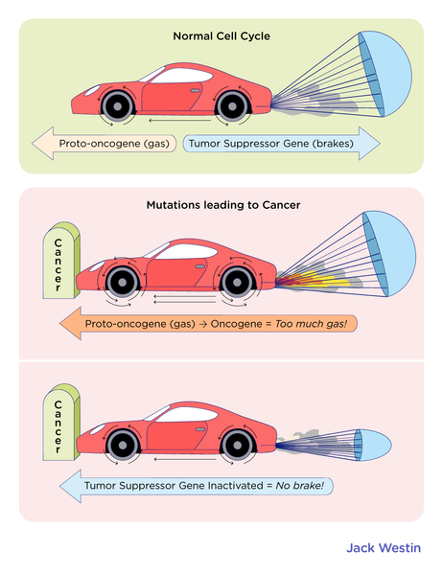
Oncogenes and Tumor Suppressor Genes
Oncogenes
RAS gene mutation
MYC gene mutation
Tumor Suppressor Genes
p53
APC
BRCA 1/2

Slide 19
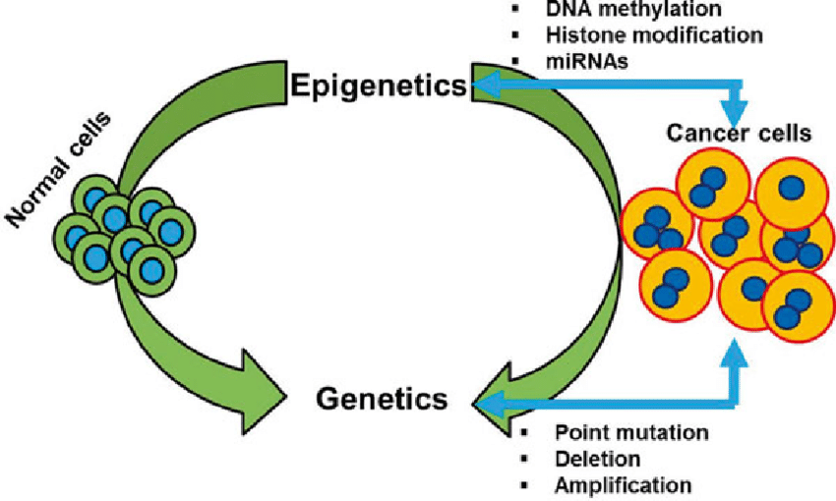
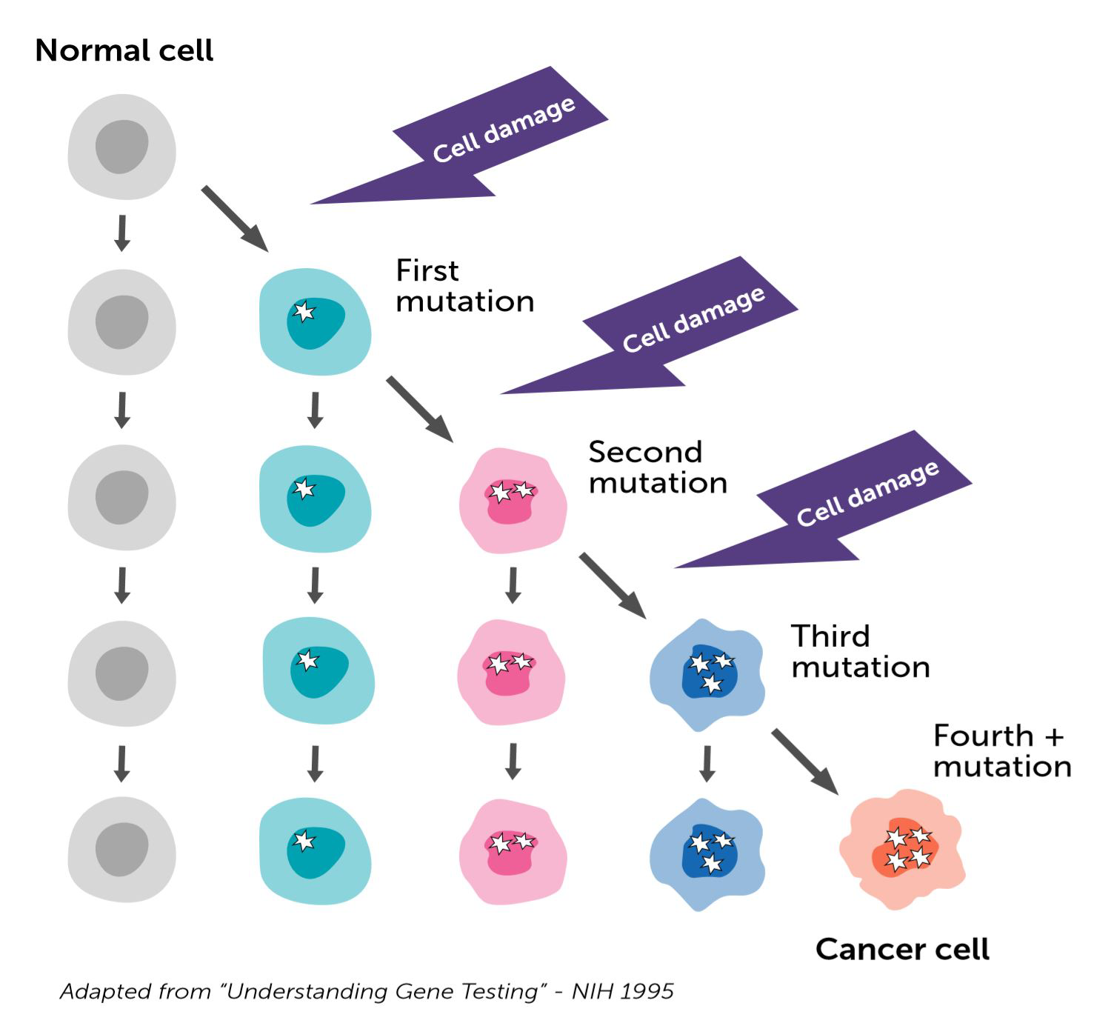
Gene Mutation

Slide 20
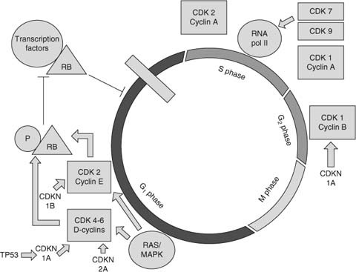
Oncogenes (RAS gene mutation) Ras proteins are proto-oncogenes that are frequently mutated in human cancers. These proteins are GTPases that function as molecular switches regulating pathways responsible for proliferation and cell survival.
Li, S., Balmain, A. & Counter, C.M. A model for RAS mutation patterns in cancers: finding the sweet spot. Nat Rev Cancer 18, 767–777 (2018). https://doi.org/10.1038/s41568-018-0076-6
Gallorini, M., Cataldi, A. & di Giacomo, V. Cyclin-Dependent Kinase Modulators and Cancer Therapy. BioDrugs 26, 377–391 (2012). https://doi.org/10.1007/BF03261895
Epidermal growth factor receptor (EGFR) is a transmembrane protein that is activated by binding of its specific ligands, including epidermal growth factor and transforming growth factor alpha (TGF-α).
p120-RasGAP (Ras GTPase activating protein) plays a key role in the regulation of Ras-GTP bound by promoting GTP hydrolysis via its C-terminal catalytic domain.

Slide 21
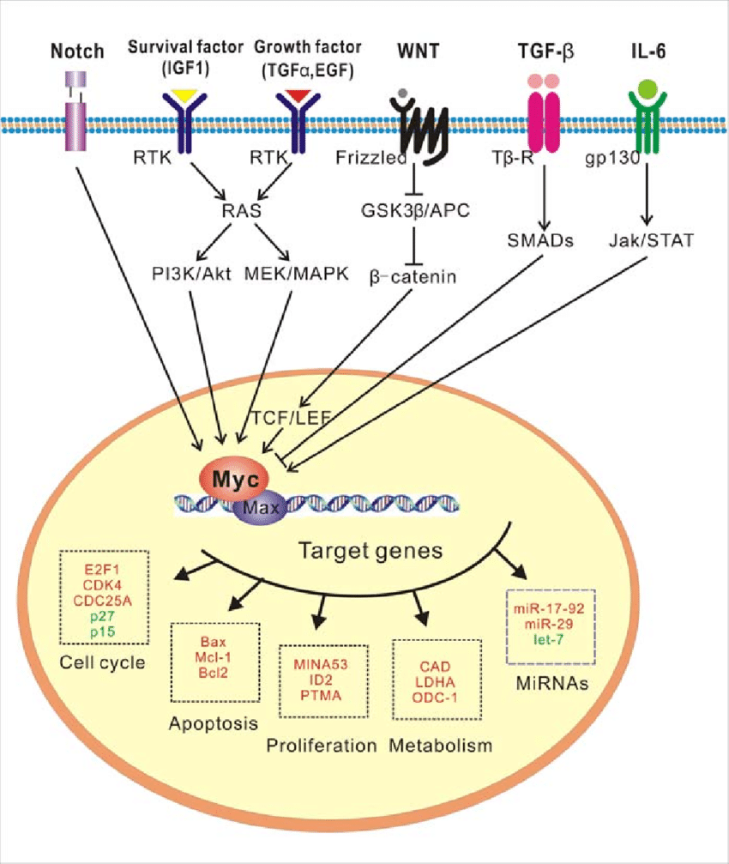
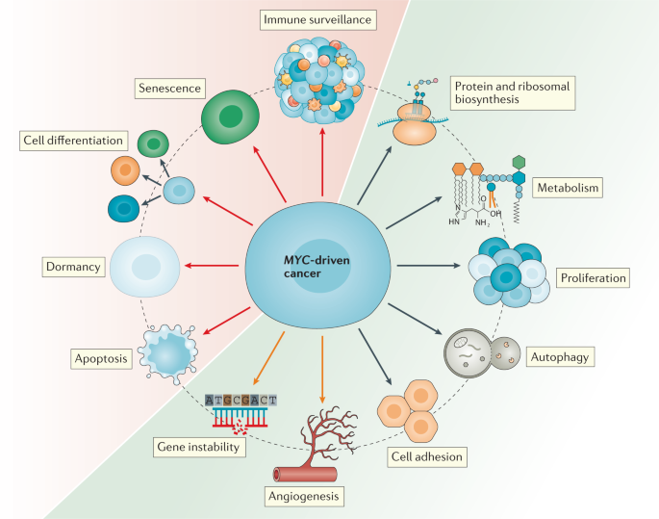
Oncogenes (MYC gene mutation)
This gene is a proto-oncogene and encodes a nuclear phosphoprotein that plays a role in cell cycle progression, apoptosis and cellular transformation. Amplification of this gene is frequently observed in numerous human cancers. Translocations involving this gene are associated with Burkitt lymphoma and multiple myeloma in human patients.
Dhanasekaran, R., Deutzmann, A., Mahauad-Fernandez, W.D. et al. The MYConcogene — the grand orchestrator of cancer growth and immune evasion. Nat Rev Clin Oncol 19, 23–36 (2022). https://doi.org/10.1038/s41571-021-00549-2
March 2014 Current Pharmaceutical Design 20(42):6543-54 DOI: 10.2174/1381612820666140826153203

Slide 22
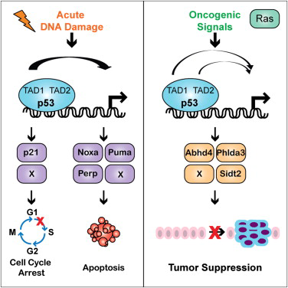
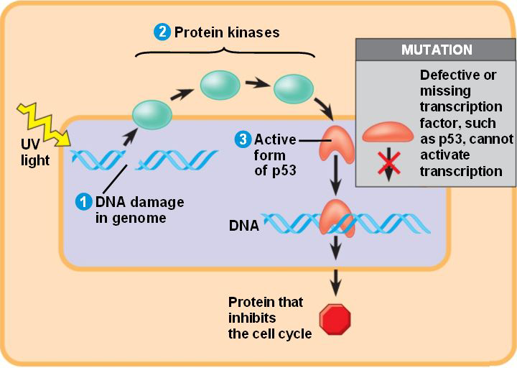
Tumor Suppressor Genes (p53)

Slide 23
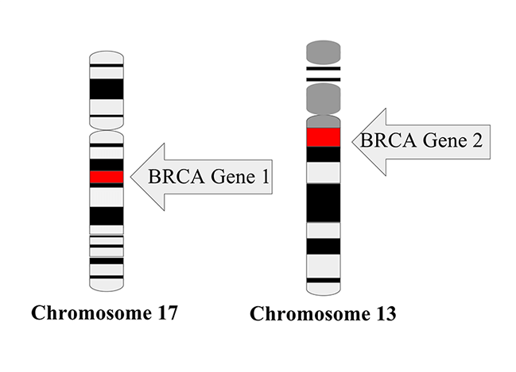
BRCA1 and BRCA2
Both men and women carry BRCA genes — BRCA1 (BReast CAncer1) and BRCA2 (BReast CAncer2) — which function as protection against breast and ovarian cancer in women, and breast and prostate cancer in men.

Slide 24
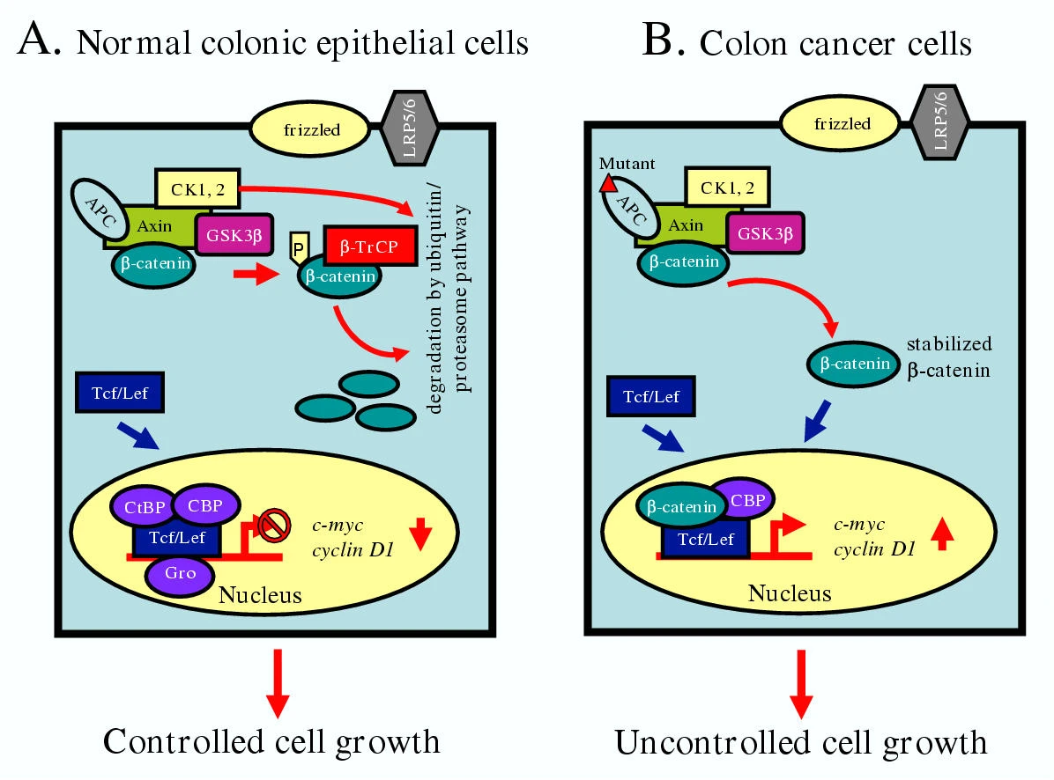
APC (Adenomatous Polyposis Coli) Tumor Suppressor
APC mutations are the most common initiator of colorectal cancer. About 85% of colorectal tumors have at least one mutation in the APC gene, while 60% have two mutations. J. Deitrick, W.M. Pruitt, inProgress in Molecular Biology and Translational Science, 2016
Wnt is a hybrid name derived from the combination of the mouse proto-oncogene int-1 and the segment-polarity gene wingless (wg) from Drosophila, which form the Wnt gene family since a revision of the nomenclature in the early 1990s. Nusse, R., Brown, A., Papkoff, J., Scambler, P., Shackleford, G., McMahon, A., Moon, R., & Varmus, H. (1991). A new nomenclature for int-1 and related genes: the Wnt gene family. Cell, 64(2), 231.
The canonical Wnt or Wnt/β-catenin signaling pathway (see figure) begins with the binding of Wnt to a receptor complex consisting of frizzled (Fz) and LRP (lipoprotein receptor-related protein).
Notes:
A model for the Wnt-signaling pathway. Panel A depicts the down-regulation of β-catenin transactivation activity in normal colonic epithelial cells. β-catenin remains in a complex of Axin/Axil/conductin, APC, GSK3β kinase and casein kinase 1 or 2 (CK1 or 2). In the absence of Wnt-signaling, GSK3β and CK1 or 2 kinases become active and phosphorylate β-catenin at serine and threonine residues in the N-terminal domain. Axin and APC promote phosphorylation of β-catenin by acting as a scaffoled protein and bringing together enzyme(s) and substrate(s). The phosphorylated β-catenin then binds with F-box protein β-TrCP of the Skp1-Cullin-F-box (SCF) complex of ubiquitin ligases and undergoes proteasomal degradation. Even though Tcf-Lef transcription factor without β-catenin may bind to DNA in the absence of β-catenin, the repressors and corepressors such as CtBP (carboxy-terminal binding protein), CBP (CREB-binding protein), Gro (Groucho), LRP (LDL-receptor-related protein) bind with Tcf-Lef and repress c-myc or cyclin D1 gene expression to control cell cycle progression. Some other known genes which are regulated by β-catenin/Tcf-Lef pathway are given here – cyclin D1, CDH1, Tcf-1, c-jun, Fra-1, PPARd, Gastrin, uPAR, MMP7, Conductin, CD44, Id2, Siamois, Xbra, Twin and Ubx. Panel B shows the role of mutations in the APC or β-catenin protein in the regulation of β-catenin level and its transactivation property in colon cancer cells. The mutant β-catenin escapes its degradation through Wnt-pathway and becomes stabilized in the cytoplasm. The stabilized level of β-catenin then heterodimerizes with Tcf-Lef transcription factor and locates into the nucleus, where it actively transcribes cell cycle related genes causing cellular proliferation. The binding of β-catenin with Tcf-Lef inhibits the binding of CtBP, CBP, Gro or LRP and potentiates its transcriptional activity.

Slide 25
Carsinogen

Slide 26
Thank you

